Slide 1
Everything You Need to Know When Utilizing Probability Panels: Best Practices in Planning, Nonresponse and Fielding
AAPOR WEBINAR
12/29/2023
David Dutwin
Ipek Bilgen

Slide 2
Building Panels: Intro
Our Presentation
Why Talk About Panels: How Panels Are Unique
Building Panels
Considering Nonresponse and Error in Panels
Fielding Studies from Panels

Slide 3
Introduction: The Uniqueness of Panels

Slide 4
Why Panels Are Unique
How Are Panels Different Than Cross-Sections?
The initial “ask” is to join a panel, not to complete a survey
Because the panelist will need to. Over time, do more work, it is not inconceivable that the effort to get panelists can more “more” than what is involved in cross-sectional research
A 2nd “ask” is typically empanelment/profiling
A “3 plus” ask is to do a lot of surveys
Panels have a relationship with their panelists
They therefore need infrastructure to deal with this ongoing relationship
The multi-stage nature of a panel requires multiple stages of, potentially, sampling, weighting, and survey operationalization
Panels need to deal with ongoing renumeration
Panels might have unique effects and nonresponse patterns
Panels live in supposed perpetuity and therefore need ongoing efforts to retain, recruit, and replenish

Slide 5
Why Panels Are Unique
Working With the End in Mind: Nonresponse In Panels
Nonresponse Types in Panels:
Recruitment: Recruits/Non-recruits
Empanelment: Dropouts or Backouts
Complete Attrition: Persons who stop participating entirely
Graduated Attrition: Persons whose cooperation rate declines
Measurements of Nonresponse:
Recruits: Whether they joined or not!!
Backouts: Whether they did any profile surveys (and/or combined with initial client surveys)
Complete Attriters: Active Status: 6-month, 12-month, etc.
Graduated Attriters: “Effective” Panelists: Using the “current” (6 mo, 12 mo) completion rate as a weight
Really a “total nonresponse” measure given nonrecruits, backouts and complete attriters will have a weight of zero.

Slide 6
Why Panels Are Unique
Combating Nonresponse in Panels
Nonresponse Mitigation Strategies:
Disproportionate Sampling for Recruits
Disproportionate Incentivization
Differential Messaging
Secondary Recruiting
Disproportionate Sampling for Surveys
Nonresponse Weighting
Post-stratification

Slide 7
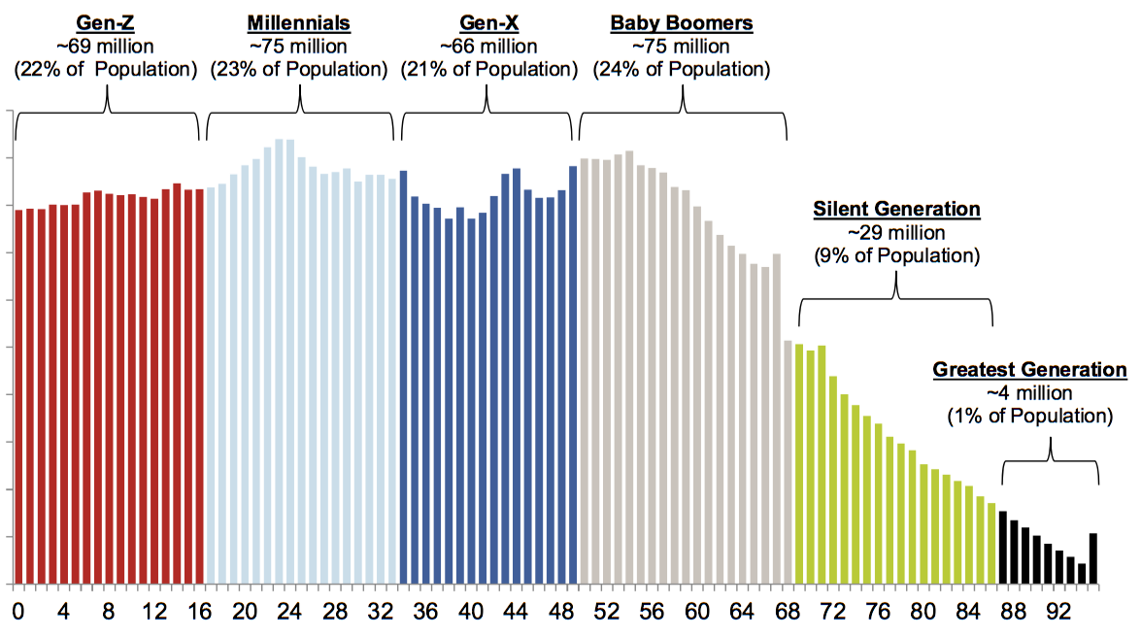
Why Panels Are Unique
The Concept of Lifecycle
Panels are not static.
Panels are like the human race: there are generations
New generations are “born”
Old generations “fade away”
As such, the loss in older generations and the insertion of new generations will change the makeup of the overall entity. (For example: Americans are more Hispanic today than a generation ago).
Source: US Census Bureau

Slide 8
Why Panels Are Unique
Thinking About The Infrastructure Needs of a Panel
Providing Incentivization
How Do People Connect?
Portal, E-mail, App, Telephone
How Do People Get Help?
What Kind of Relationship Do You Create?
The nature, frequency, and type of communication, unrelated to taking actual surveys
The nature, frequency, and type of communication about taking surveys
Maintaining Current Data About Panelists

Slide 9
Building Panels

Slide 10
Building Panels: Intro
Questions to Consider in Building Panels
Maintenance and Growth
Sampling Frame and Sampling Strategies
Non-Internet Coverage
Modality of Recruitment
Effort: Number of mailings, calls, incentive amounts, use of a NRFU
Empanelment Requirements
Infrastructure: Portal, App, Helpdesk, Incentivization Structure, etc.
Panelist Relationships, Engagement and Retention

Slide 11
Maintenance and Growth

Slide 12
Building Panels: Maintenance and Growth
“How Large Is Your Panel?” Know What Number Your Panel Company is Quoting You
Notes:
Change the x axis to an index

Slide 13
Sampling Frame and Sampling Strategies

Slide 14
Building Panels: sampling
Sampling Options
Sample Frame | Area Probability | DSF | RDD
Household Sample Coverage Rate | 97% | ~92% | ~96%
Coverage Challenge | Clustering | Rural | Blocking and Screening
Typical Operationalization | Mail Push-to-Web/Multimodal | Mail Push-to-Web/Multimodal | Phone

Slide 15
Building Panels: sampling
Nonresponse Follow-Up (2014–2018 and 2021–Present)
2014
‘15
‘16
‘17
‘18
‘19
‘20
‘21
2022
Pilot Phase
Panel is Founded
GenForward
Racially and ethnically diverse young Americans
(ages:18-34)
Spanish Recruitment Field Experiments
Improving Sample Representation at the State Level
Utilizing Big Data Classifiers
Foresight 50+
AANHPI Panel Pilot
New Latino Panel
Incentive Experiments
H2R segments
NRFU Recruitment
NRFU Recruitment
Oversample areas and HHs with higher concentration of young adults, Hispanics, and NH African-Americans

Slide 16
Building Panels: sampling
Impact of Big Data Classifier Sample Stratification on Recruiting

Slide 17
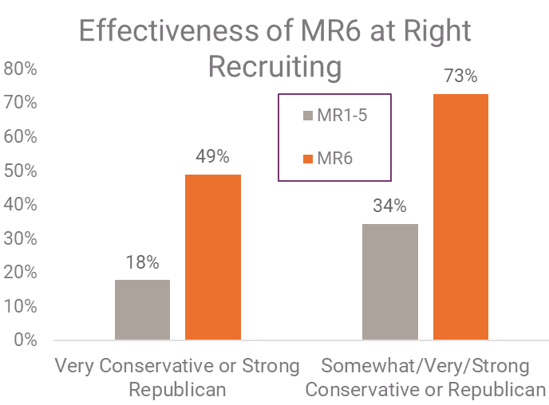
Building Panels: level of effort
Recruiting Special Populations
AmeriSpeak 2021 Spanish Language Recruit
Case Status | N | %
TOTAL | 2,000 | 100%
Complete | 432 | 22%
Hispanic | 1,801 | 90%
Spanish: Fluent Read/Speak | 1,702 | 84%
Spanish survey takers | 980 | 49%

Slide 18
Non-Internet Coverage

Slide 19
Building Panels: Non-Internet coverage
The digital divide continues to narrow, but a sizeable portion of Americans remain offline
American Community Survey (ACS) 1-Year Estimates 2016-2019.
Notes:
All of us are likely aware of the growth of Internet use among the US population and the narrowing of the digital divide. This chart illustrates the narrowing of the digital divide using ACS data. In 2016, 18% of US HH had no internet subscription... orange line... and by 2019, it was 13%. This is still a sizeable group we can't ignore.
Most recent data from the American Community Survey (2019) finds 13.4% of U.S. households are without any Internet subscription.
Pew Research Center (2021) asks respondents whether they personally use the Internet, finding that 7% of U.S. adults do not.
The true size of the non-Internet population is difficult to pinpoint, but likely falls somewhere between these estimates.

Slide 20
Building Panels: Non-Internet coverage
The non-Internet population is different from those who use the Internet
Differences related to age, income, education, metropolitan status, and race (Antoun et al. 2015; Dever et al. 2008; Norris 2001; Robinson et al. 2002; Robinson and Martin 2005; Zhang et al. 2008; MacDonald and Hülür 2021)
Differences in their attitudes and behaviors (Dutwin and Buskirk, 2022)
Less trusting of politicians, less politically engaged, score lower on political knowledge questions
More skeptical of science; More religious; Lower overall health; More isolated, participate less in community events, talk to fewer people daily, and less willing to date outside racial group
Various research also noted gaps in cultural, economic, environmental attitudes, and group participation among internet and non-internet populations (Norris 2001, Robinson et al. 2002, Robinson and Martin 2005; Zhang et al. 2008)

Slide 21
Building Panels: Non-Internet coverage
Strategies to include the non-Internet population
Providing Devices and/or Connections
PRO
Single mode requires less complex management
CON
Does not fully solve the nonresponse mode problem; those who are reluctant to use the Internet are less likely to participate
Time and resources required to set up and manage devices
Mixed Mode Approach with “Offline” Mode
PRO
Solves the nonresponse mode problem; those who do not want to use the Internet can participate
CON
Requires integrated sample management and data collection system
Potential mode effects
Leenheer & Scherpenzeel, 2013; Hoogendoorn and Daalmans, 2009; Reveilla et al., 2016; Cornesse, 2021; Reveilla et al. 2016; Bertoni, 2019; Dillman et al., 2009.
Notes:
Providing Devices and/or Connections:
PRO - Single mode requires less complex management
CON –
Does not solve the non-response mode problem; those who don’t want to use the Internet will not participate
Studies in Europe find that non-Internet units join panels less often than Internet units, even when provided free equipment
Studies in the U.S. and Europe have shown that non-Internet panelists who accept offers of access and/or equipment take fewer surveys than Internet panelists
Agreeing to receive new technology, to keep it charged, and to keep it nearby can be substantial hurdles for those that do not use the Internet.
There is a significant sub-group of the non-Internet population who do not want to use the Internet and those who use the Internet for some things but don’t want to use it for surveys (because of security or other concerns). These people won’t participate in this approach.
Time and resources required to set up and manage devices -- determining eligibility, selecting devices, negotiating prices, delivering and setting up devices, training panelists, ongoing tech support and device management

Slide 22
Modality

Slide 23
Building Panels: Modality
Modality of recruitment
Most of the probability-based panels are using ABS, RDD, or a combination of both as their sample frame
In most cases, panel recruitment mode is different than the recruitment questionnaire data collection mode, as well as the mode of panel sign-up process
For instance, probability-based panels that use an ABS frame initially start mailing recruitment materials to the sampled households and invite the households to join the panel through web or in-bound phone mode.
The different recruitment and data collection/panel sign-up modes decrease costs, increase response rates, improve coverage, and decrease nonresponse error

Slide 24
Building Panels: Modality
Modality of recruitment
Probability based online panels can also concurrently administer the recruitment survey and panel sign-up process through different modes
One of the most commonly used strategies is to provide sample members with a mode choice
For instance, the recruitment mailing can provide both an URL link to the recruitment survey as well as an 800-phone number for the sample member to call in to respond to the recruitment survey and sign up to the panel
This method is mainly used to cover non-Internet populations and improve coverage as well as increase response rates
Subsequently, this method reduces coverage and nonresponse error and improves the sample composition in panels

Slide 25
Building Panels: Modality
Modality of recruitment during nonresponse follow-up
Most probability-based panels use a different contact mode during nonresponse follow-up (NRFU) phase than the mode used during the initial recruitment contact phase
This method is used in order to increase recruitment response rates, reduce nonresponse error, and improve panel composition
The rationale of this approach is to start the recruitment using the least expensive method and provide advance notification for additional nonresponse follow-up efforts
Mixing modes during subsequent surveys after the recruitment
Many probability-based online panels use different mode(s) to collect data in subsequent surveys than in recruitment
For instance, once panelists join AmeriSpeak, they are offered the ability to select their preferred mode of participation: web or phone
This is mainly done to reduce costs, collect data faster, and increase data collection efficiency

Slide 26
Effort: Number of mailings, calls, incentive amounts, use of a NRFU

Slide 27
Building Panels: Level of Effort
Choices in Level of Effort
In Recruiting
Number/type of mailings/phone attempts
Incentivization strategies
Modalities offered
Use of a NRFU
In Retainment
Engagement Activities
Help Desk
Secondary Efforts

Slide 28
Building Panels: level of effort
Initial Recruitment
Pre-notification postcard
+5 days, 9 x 12 recruitment packet w/ pre-incentive ($5), study brochure, and privacy policy.
+11 days, reminder postcard
+18 days, reminder postcard
Call-ins allowed throughout
+25 days, call-outs to matched telephones
Post-incentive $25
NRFU Recruitment
Federal Express study brochure and 2x pre-incentive
In-person recruitment

Slide 29
Building Panels: NRFU
NRFU boosts response rate
by 3 times
A little more than half of panelists have been recruited
during the NRFU recruitment stage

Slide 30
Empanelment Requirements

Slide 31
Building Panels: empanelment
Profiling
Panels are unique in their collection of profile variables of panelists:
Typical topics include:
Health
Health insurance
Health conditions
Political participation
Political knowledge and attitudes
Technology use
Detailed financial status
Ownerships (home, cars, etc.)
Hobbies, etc.
Not all panelists complete profile variables; panel can vary in their demand that such profiling be completed to become a member
Profile variables can be used to target subpopulations (e.g. a survey of persons without health insurance); weighting (rare), and/or provided as additional "value add" variables in client datasets
Profiling typically includes timely data (e.g., health insurance status, health status, stock ownership, etc), so periodic refreshing of panel data is critical

Slide 32
Infrastructure

Slide 33
Building Panels: empanelment
Infrastructure
Panels range in their level of complexity, but generally, the larger they are the more they require extensive infrastructure
Web Panel Portal
Email/Text Ops
Client Services
Panelists
App
Biz Dev
Operations
Telephone Center
Stats and Methods
Mail Ops
Help Center

Slide 34
Panelist Relationships, Engagement and Retention

Slide 35
Building Panels: Retention and engagement
Panelist retention and engagement
Communication with panelists after the recruitment:
Welcome packet
New recruit mailings (in experiment phase)
Profile surveys
Client surveys
Birthday greeting cards
Quarterly newsletters
Surveys administered to refresh demographics (periodically)
Engagement efforts for under-represented populations
E.g., Hispanic engagement (in experiment phase)
Notes:
Too little communication decreases panelist engagement
Too much communication increases panelist burden

Slide 36
Building Panels: Retention and engagement
Overview
Research question: How to best retain Hispanic and Latino respondents in AmeriSpeak?
Hypothesis: Latino-focused engagement will increase retention
Experimental design:
2x2
Series of engagement surveys on Latino issues (yes/no)
Series of infographics using survey results on Latino issues (yes/no)

Slide 37
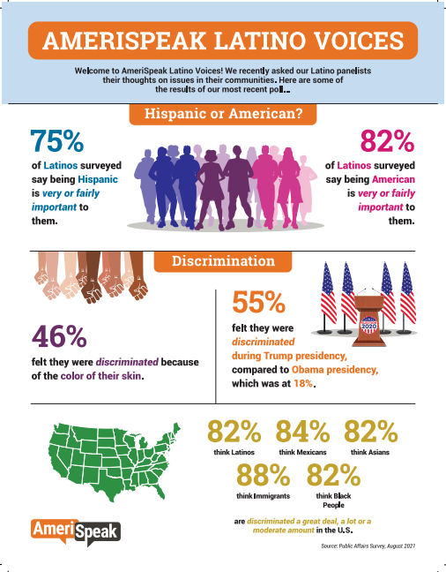
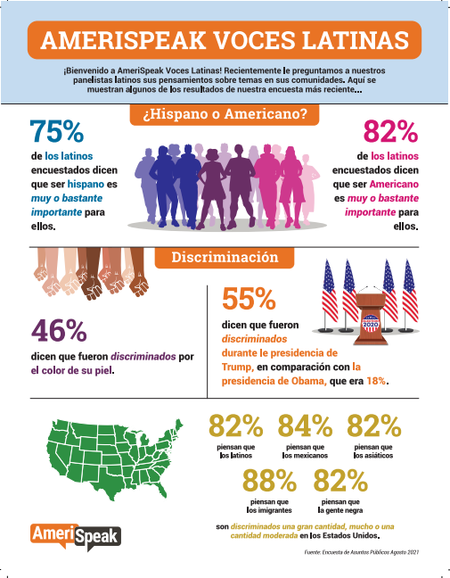
Building Panels: Retention and engagement

Slide 38
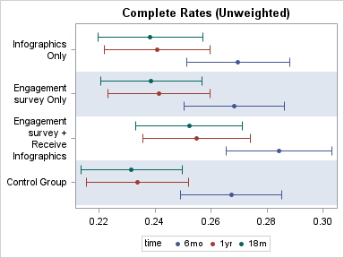
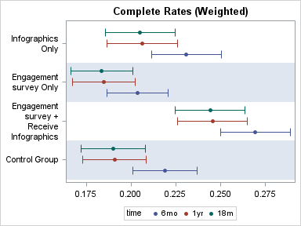
Building Panels: Retention and engagement
Completion Rates
Highest to lowest
Engagement survey + Infographic
Infographic
Engagement survey
None
Rates drop across time

Slide 39
Panelist Relations : retainment
New Recruit Mailings Experiment
Research Objective: Assess if engagement mailings and emails sent in the first six months of empanelment impact participation rates and retention
Sample Universe: Newly recruited panelists, >=18
Experiment Groups:
No mail or email
Email-only
Mail-only
Both mail and email

Slide 40
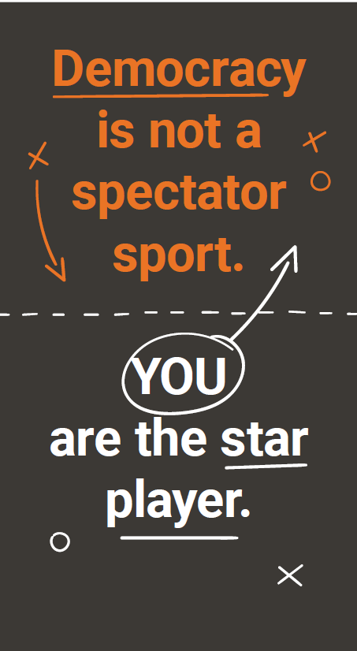
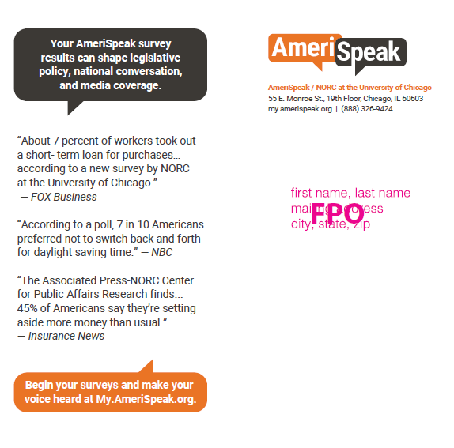
Overview
New Recruit Mailings

Slide 41
Panelist Relations : New recruit mailings experiment results
Notes:
Mail or Email treatment groups have shown a higher completion rate when compared to the control (no additional contact). Receiving both mail and email treatment group showed a lower completion rate compared to the control.

Slide 42
Response and Error in Panels

Slide 43
Response and error in panels
Review: Issues in Panel Quality and Potential Error
Response rates
Overall representativeness
Considering recruiting effort on nonresponse
Considering modality/mode effects
Panel conditioning
Dealing with cheaters/panelists that provide suboptimal responses
Transparency

Slide 44
Response rates

Slide 45
Response and error in panels: response rates
Response Rates in Panels

Slide 46
Overall Representativeness

Slide 47
Response and error in panels
All recruited panelists
Started at least one survey (non-backouts)
Active panelists
Effective panelists
Recruited Panelists
Back-out cases
Started at least one survey
Active Panelists
Effective Panelists

Slide 48
Response and error in panels: panel representativeness
When panels say they are representative, well, it depends what they are talking about!
Notes:
Change the x axis to an index

Slide 49
Response and error in panels: panel representativeness
Panelists have a “honeymoon” period that lasts about 6 months
There is then a slower decline in participation over time that is markedly flat
Year/Quarter
Notes:
Change the x axis to an index

Slide 50
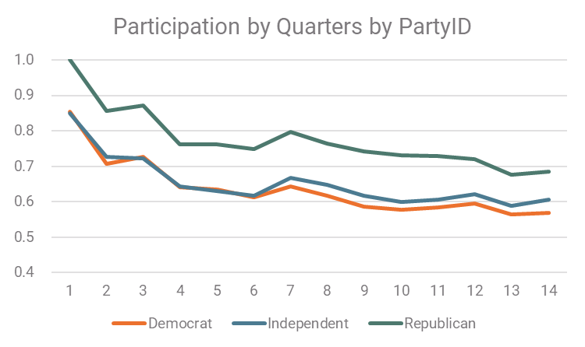
Response and error in panels: panel representativeness
Systematic Nonresponse Over Time?
AmeriSpeak research finds little change over time in nonresponse (from where panelists initially start)
Notes:
Change the x axis to an index

Slide 51
Response and error in panels: panel representativeness
Systematic Nonresponse Over Time?
AmeriSpeak research finds change in most variables
Notes:
Change the x axis to an index

Slide 52
Considering recruiting effort on nonresponse

Slide 53
NONRESPONSE FOLLOW-UP EFFORTs during Recruitment : USING a MULTI-MODE strategy
Initial Recruits
NRFU Recruits
Benchmark

Slide 54
NONRESPONSE FOLLOW-UP EFFORTs during Recruitment
NRFU Produces Different Estimates for Measurement of Attitudes and Opinions (even after weighting)
 | Items different at p = 0.05
Gun Control | 10/39 = 25.6%
GSS | 5/29 = 17.2%
NASA | 4/17 = 23.5%
Overall | 19/85 = 22.4%
Statistical significance is determined by a χ2 Test (NRFU vs. Initial)

Slide 55
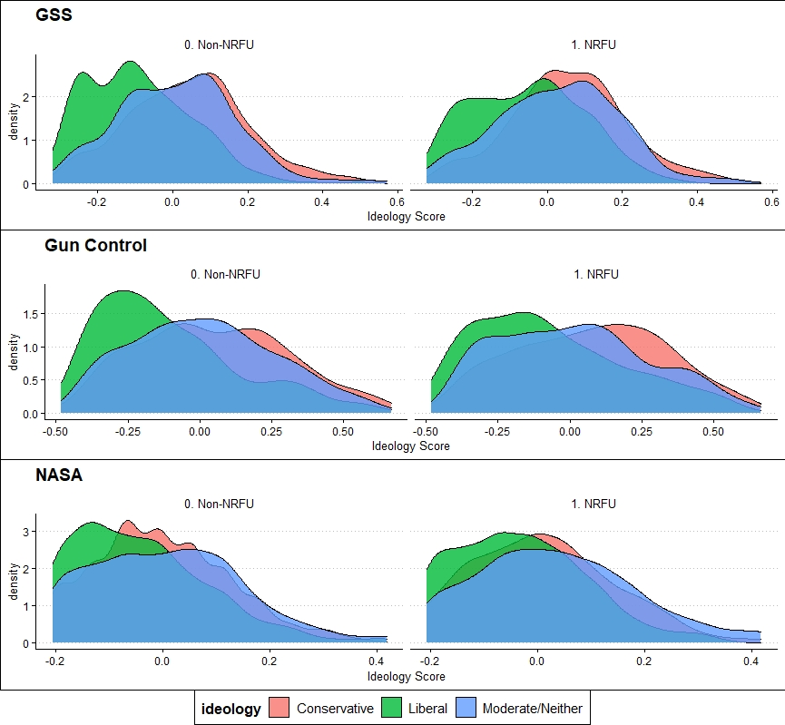
NONRESPONSE FOLLOW-UP EFFORTs during Recruitment
Initial and NRFU respondents differ politically
NRFU panelists are more conservative and self-identify as more moderate
Notes:
For NRFU respondents, we see a tighter clustering of scores around the middle for all three ideological groups (liberals, moderates, and conservatives)

Slide 56
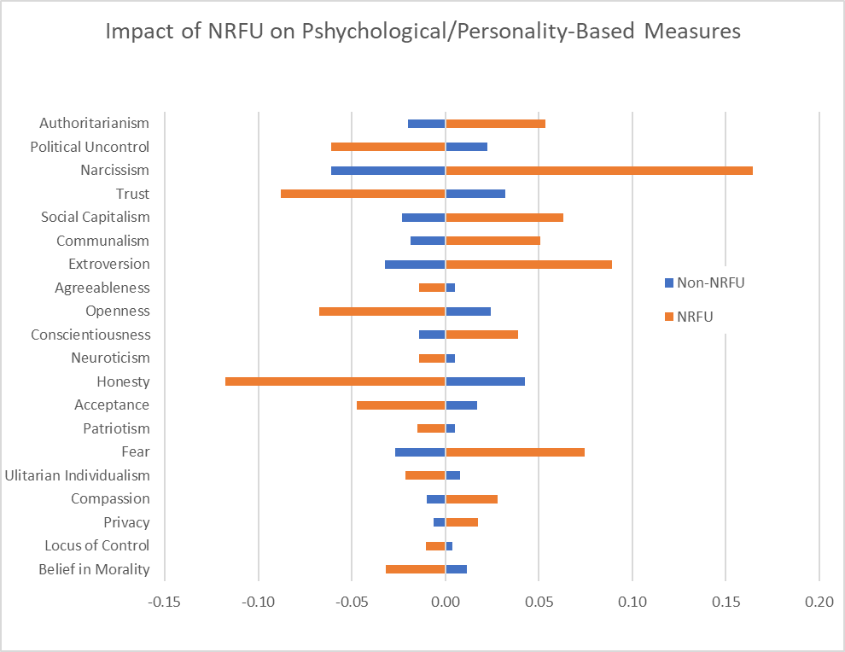
NONRESPONSE FOLLOW-UP EFFORTs during Recruitment
Significant ways NRFU decreases bias:
Narcissism
Extroversion
Social Capital
Political Uncontrol
Conscientiousness
Belief in Morality

Slide 57
Considering modality/mode effects

Slide 58
Error sources in panels: Mixed Mode Approach
Mode measurement effects during panel survey data collection
While a mixed mode methodology improves representativeness and reduces costs, it can also potentially increase mode measurement effects
Researchers want to maximize representativeness
Researchers want to minimize mode effects
Are the differences in estimates due to mode effects vs. composition differences (sample representation)?
Conducted a study to assess this question
Examined ~100 items
Panelist usual mode
Experimental study mode
Phone
Phone
Phone-Phone
Phone
Web-Phone
Web
Web
Web-Web

Slide 59
sample composition VS. MODE MEASUREMENT effects : EXAMPLE QUESTIONS
Are the differences due to composition or the survey mode?

Slide 60
sample composition VS. MODE MEASUREMENT effects : RESULTS
Are the differences due to composition or survey mode differences?
 | Different at p = 0.05
Selection (Composition differences) | 22%
Measurement (Mode effects) | 10%
Both | 7%
None | 61%
TOTAL | 98 items

Slide 61
Mode measurement effects IN PANELS: TAKE-AWAYS
Any bias from mode measurement effects is small in comparison to the bias of not fully covering the non-Internet population
Consistent results: Literature on mode effects and recent AmeriSpeak research
(De Leeuw 2005, 2018; Dillman et al. 2014; Medway and Fulton 2012; Messer and Dillman 2011)
Offering a mixed-mode design improves sample coverage and representativeness
Those who choose to complete a survey in one mode (phone) are very different than those who choose to complete the survey in another mode (web)
Be aware of potential mode effects when designing questionnaire
Limit questions prone to social desirability bias

Slide 62
Panel conditioning

Slide 63
Panel Conditioning
Panel conditioning is the change in a person’s survey responses that is influenced by their panel tenure and panel experiences
Examples of panel conditioning effects
Improve quality: As their panel tenure increases panelists may be more willing to offer an opinion, reducing no opinion and DK survey responses
Degrade quality: More tenured Panelists learn to take surveys more quickly by refusing to answer survey questions more often than less tenured panelists
Positive or negative influences on repeated measures
Improve quality: when respondents have the time to think about the inquired topic
Degrade quality: when the panelists change their true attitudes and behaviors due to exposure to the topic in past surveys
Notes:
Balance of data quality and sample representativeness….
The literature describes increased knowledge as both good and bad for data quality/sample representativeness. Good for reducing no opinion and DK responses but bad as it causes change in their behavior, knowledge, and attitudes. So, they may become no longer a representation of the people w/ same demographics.
Opinionation effect would just be evidence of that certain populations are more likely to opinionate than others. We are concerned with NRFU because if easy to interview persons are differentially opinionated than hard to reach persons, then surveys in general are suspect to survey bias due to opinionation.
In a research about the impact of NRFU in AmeriSpeak, Ipek Bilgen found that inclusion of NRFU increased the representation of moderate-to-conservative opinions, leading to different, more inclusive numbers. This experiment is following up on that paper.
Such persons may be more likely to voice nonattitudes than others, as well as voice opinions on topics for which they only have modest knowledge of, or have a more “black and white” view of things and therefore are more likely to answer survey questions that are bipolar.

Slide 64
Research CONSTRUCTS: Research questions
Does Panel Tenure Matter? Recent AmeriSpeak Research
Willingness of offering an opinion?
Become more knowledgeable and interested?
Provide more extreme responses to attitudinal questions?
Provide more moderate and/or no opinion responses?
Provide more or less item non-response, speeding, and satisficing?

Slide 65
summary: conditioning Constructs 1-5
Results in Literature and Recent AmeriSpeak Research Consistent: Generally Weak to Null Effects
Increase in willingness to offer an opinion – No evidence of a difference in willingness to offer an opinion
Increase in Knowledge – Later responses were found to be somewhat more accurate
Response extremity – No evidence that panelists change in extremity
Change in no opinion responses – No evidence of change
More or less item non-response, speeding, and satisficing – No change in item nonresponse; Survey length somewhat larger for later responses; No evidence in difference in satisficing
Panel conditioning effects are generally either insignificant or modest and often tending to improved response
Notes:
Overall, prior literature and our own research finds that panel conditioning in multi-client panels is not a major, nor even minor, concern. Nevertheless, in situations where prior research has found more notable effects, such as with repeated knowledge-based measurements, researchers should continue to be wary of the existence of such effects and consider ways to mitigate them, such as with longer periods between the repetition of questions and/or a design that ensures, if possible, different panelists across waves.

Slide 66
Dealing with cheaters/panelists that provide suboptimal responses

Slide 67
The Use of Data Cleaning Procedures in Panels
Users of online panel data are concerned about potential data quality issues introduced by three types of respondents.
Fraudulent respondents
Professional respondents
Inattentive respondents
Complete multiple surveys
Misrepresent themselves at sign up
Misrepresent themselves in screening
Belong to multiple panels
Complete large numbers of surveys
Speed
Straightline
Give non-substantive answers
Skip items
Notes:
Fraudulent respondents:
Complete multiple surveys (can use automation, bots)
Misrepresent themselves when they sign up for a panel
Misrepresent themselves during screening to qualify for surveys
Inattentive respondents:
Speeding– completing the survey more quickly than is expected given the nature of the questions and responses
Straightlining or response non-differentiation - answering questions in a grid by selecting the same response for all items; showing low differentiation in response patterns
Using non-substantive response options – e.g., “don’t know ” or “decline to answer”
Skipping items
Task: Conduct literature review and produce white paper to explain why these issues are more of a concern for nonprobability-based panels than probability-based panels.

Slide 68
The Use of Data Cleaning Procedures in Panels
These data quality issues are more of a concern for nonprobability-based panels because of their sampling and recruitment methods.
Probability-based panels
Select and recruit panelists from a set sampling frame
Recruit using well-established contact modes
Researchers have precise control over who is invited and allowed to join
Nonprobability-based panels
No set sampling frame
Use ads to recruit
Successful recruitment requires seeing an ad and self-selecting into membership
Fraud easier
Burden higher and thus potentially more professional respondents
Notes:
Therefore that their data cleaning procedures should be stricter than those for probability-based panels.

Slide 69
The Use of Data Cleaning Procedures in Panels
Both probability and nonprobability-based panels may have inattentive respondents: Skippers, Speeders and Straightliners.
Data cleaning best practices:
Reviewing time stamps for short survey completion times or abnormal dwell times
Looking for straightlining or randomly selecting answers in grid questions
Reviewing the number of questions with non-substantive answers or refusals
Reviewing verbatims or continuous numerical responses
Aggressive data cleaning procedures can create coverage issues.
Many of these behaviors also have origins that are unrelated to satisficing.
Excluding respondents based on certain behaviors can worsen systemic bias.
Greszki et al, 2014; Malhotra, 2008; AAPOR, 2010; Le Guin 2005; Bertoni, 2022; Yan and Tourangeau, 2008; Heerwegh, 2003; Tourangeau, Couper, & Conrad, 2004; AAPOR, 2010; Kim et al, 2019.
Notes:
Data cleaning best practices:
Reviewing time stamps for short survey completion times or abnormal dwell times
Looking for straightlining or randomly selecting answers in grid questions
Reviewing the number of questions with non-substantive answers or refusals
Reviewing verbatims or continuous numerical responses for word count, gibberish, clear internal consistencies, and copy-paste responses
Avoid aggressive data cleaning procedures that can create coverage issues.
Many of these behaviors also have origins that are unrelated to satisficing.
Excluding respondents based on certain behaviors may worsen systemic bias.

Slide 70
The Use of Data Cleaning Procedures in Panels
Instructional Manipulation Checks (IMCs) to identify and minimize suboptimal responses and inattentive respondents?
IMCs are also referred to as “trap” questions, red herrings, attention checks, validation questions, and instructed response items. However:
IMCs can compromise trust between panelists and researchers
Use of IMCs tend to exclude panelists that may exacerbate systematic bias
Respondents most likely to fail IMCs are also part of communities with historical patterns of survey nonresponse (e.g., younger populations, people with lower educational attainment, etc.)
Risk of automated bots, fraudulent respondents, etc., is lower than in nonprobability-based surveys and panels
Example 1. For quality assurance purposes, please select “strongly agree” below.
Strongly agree
Agree
Neither agree nor disagree
Disagree
Strongly disagree
Example 2. Please verify where you are in the survey by marking “2” for this item.
1
2
3
4
5
Notes:
To increase survey data quality, survey researchers seek to design web instruments that identify and minimize suboptimal responses and inattentive respondents. Various strategies have been developed by survey researchers to do so, including the use of instructional manipulation checks (IMCs) that are also referred to as “trap” questions, red herrings, attention checks, validation questions, and instructed response items. The use of IMCs makes sense on its face (who wouldn’t want to catch people not paying sufficient attention to the survey of which they are responding), and thus have been recommended by a number of researchers (Gummer et al. 2021; Liu and Wronski, 2018; Jones, House, and Gao, 2015; Hauser and Schwarz, 2015; Berinsky et al., 2014; Miller and Baker-Prewitt, 2009). However, the efficacy of using IMCs to identify and remove inattentive respondents is mixed in the literature, with many raising concern that the practice does more harm than good, especially in the context of probability panels. AmeriSpeak recommends using IMCs with extreme caution in probability panels and for their use to be limited to studies with a content-driven justification for their inclusion.
Examples of IMCs include “For quality assurance purposes, please select ‘strongly agree’” (Downes-Le Guin et al. 2012) and “Please verify where you are in the survey by marking ‘2’ for this item” (Miller and Baker-Prewitt, 2009).

Slide 71
Transparency

Slide 72
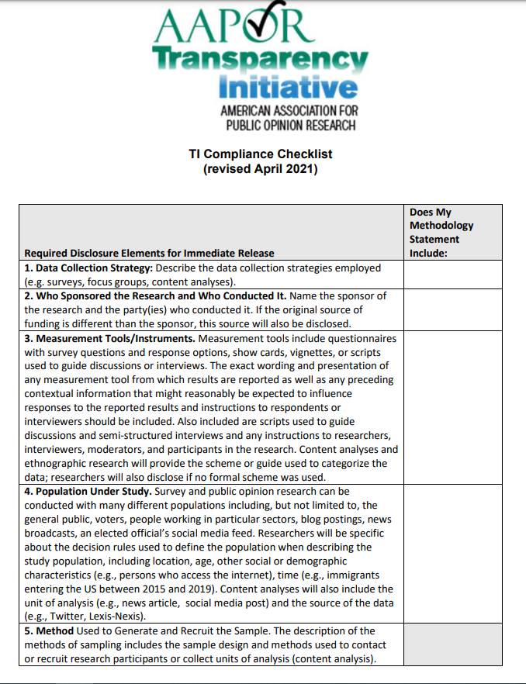
Transparency
What is the AAPOR Transparency Initiative (TI)?
TI members commit to routinely disclosing the research methods associated with their studies
Disclosure can be to clients or publicly when NORC is releasing the study
Includes 11 disclosure elements for immediate release
Additional elements that should be released upon request within 30 days

Slide 73
Transparency
Standard Disclosure in Project Reports
Rights of Human Subjects Documentation
Panel Construction Protocol
Within-Panel/Study-Specific Sampling Protocol
Gaining Cooperation Protocol
Schedule of Email/SMS texting/Outbound Phone Outreach
Respondent Incentives
Data Quality Inspection Reviews
Response Rate Reporting by Component (using AAPOR Standard Definitions)
Weighting Complete Documentation
Base weighting
Post-stratification weighting
Trimming rules
Control totals and benchmarking sources

Slide 74
Transparency
Special Disclosure For Panels
Given the “Two-Stage” Nature of Panels, it Behooves Panels That Aim to Be Transparent to Provide Documentation on the 1st Stage
As An Example, AmeriSpeak Provides Three Documents:
Technical Document (https://amerispeak.norc.org/content/dam/amerispeak/research/pdf/AmeriSpeak%20Technical%20Overview%202019%2002%2018.pdf)
Sample frame documentation; recruitment sampling strategies by year; Panel recruitment procedures; Recruitment response rates; NRFU details; Mixed-mode details; Panel maintenance
OMB Clearance Document (https://amerispeak.norc.org/content/dam/amerispeak/research/pdf/AmeriSpeak%20Guide%20for%20Obtaining%20OMB%20Approval.pdf)
Information required for OMB clearance including survey planning; survey design; pretesting protocols, data collection protocols; notifications to survey respondents; detailed methodologies; data editing procedures; nonresponse analyses and panel response rates; coding procedures; protection of data
Weighting Document (under revision)
Detailed documentation on panel weights; detailed documentation on study weighting

Slide 75
Panel Surveys: How are panelists deployed and employed for surveys?

Slide 76
Response and error in panels
Fielding Surveys in Probability Panels
Sampling for studies
Options in fielding
Use/Burden
Outreach strategies to bolster response
Weighting

Slide 77
Sampling for studies

Slide 78
sampling for studies
Considerations in Study Sampling
Ensuring even use
Needing to generate a random sample of respondents
Needing to ensure panelists are used equally
Needing to ensure panelists participation is evenly spaces
A potential to reduce nonresponse
Sample stratification to release proportionate to Census counts
AmeriSpeak: 48 strata gender x educ x race/ethnicity x age
Potentially sample based on historical cooperation rate

Slide 79
Use/Burden

Slide 80
Use / Burden
Differential burden by demographics
AmeriSpeak uses its panelists 3x less than typical nonprobability samples

Slide 81
Use / Burden
The typical respondent has now been in the panel for over three years.

Slide 82
Options in fielding

Slide 83
Fielding
Considerations in Study Fielding
How to alert panelists
CAWI panelists might get a different method than CATI
When and how often
How many texts / calls / emails
How are all spaced out
How much to incent
Based on length / burden / response rate goals
How long to field
Longer generally garners higher response, but without repeated / more spread-out interventions, with less impact
Whether to do anything further
Options not part of the standard method
prenotification mailings, nonresponse mailings, etc.

Slide 84
Outreach strategies to bolster response

Slide 85
Additional Outreach strategies
Strategies to increase cooperation in panel surveys
Targeting inactive and intermittent panelists
Using a different contact mode (e.g., mail) than the usual contact mode (e.g., web and phone)
Pre-notification letters (USPS mailings)
Pre-completion cash incentives
Re-establishing social trust
Messaging & Convenient questionnaire access
Sending study-specific URL + PIN instead of directing them to panel portal
Reducing panelist burden
We examined which of these interventions work for low-cooperation segments of the panel

Slide 86
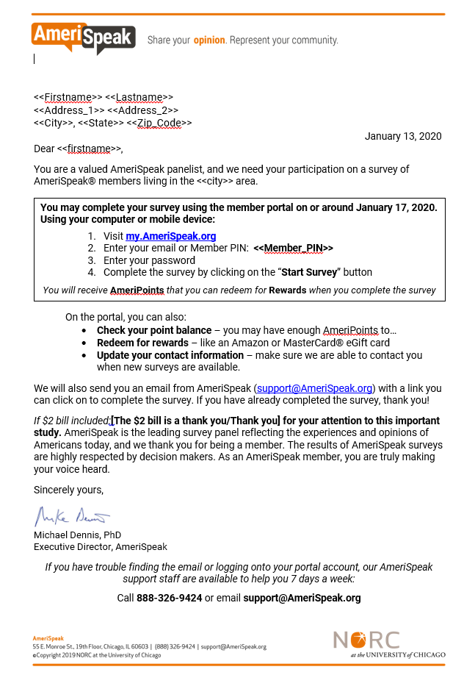
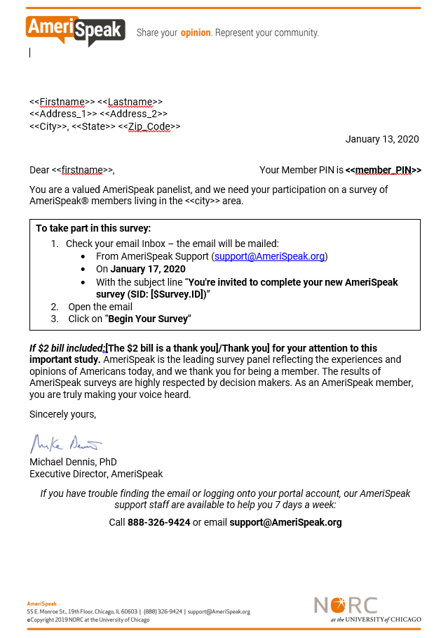
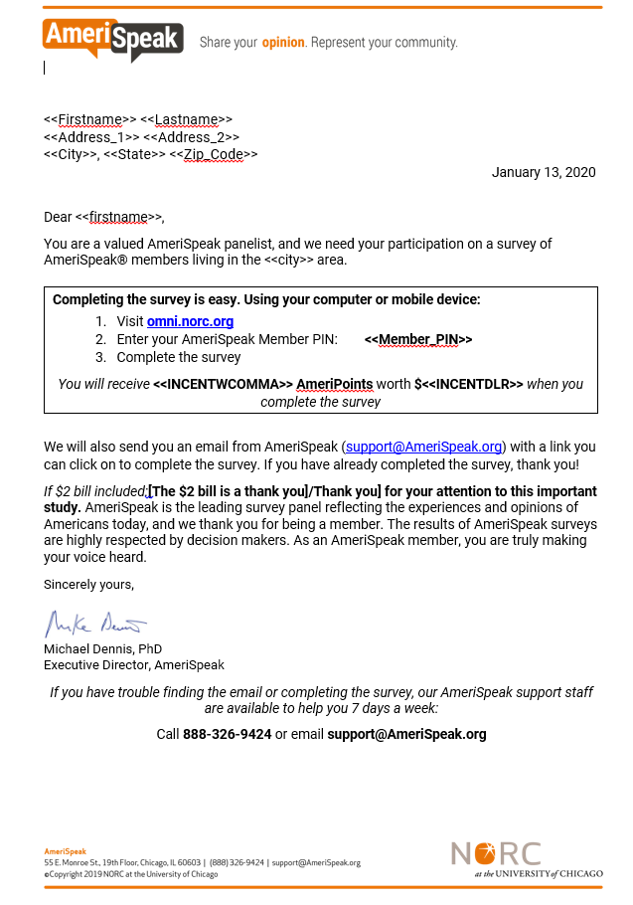
Additional Outreach strategies : Pre-notification Letter Designs
Generic
Detailed
URL

Slide 87
Additional Outreach strategies : Survey Cooperation by Treatment Group
Examining detailed experimental groups shows URL letter with $2 incentive resulted in highest cooperation rate, with the generic letter resulting in the second highest rate
$∆$ in Survey Cooperation Compared to Control Group
+3.7%
*p-value = 0.0627
+3.5%
*p-value = 0.0843
+5.5%
***p-value = 0.0060
+4.4%
**p-value = 0.0286
+6.6%
***p-value = 0.0010
+3.0%
p-value = 0.1354
Note: Rates presented are unweighted

Slide 88
Additional Outreach strategies : Survey Cooperation by Activity Level
Intermittent and somewhat active panelists see largest percentage point increases in survey cooperation rates from interventions
Note: Rates presented are unweighted. Completion rates used to determine activity level are calculated for the June 2019 – Dec 2019 period

Slide 89
Additional Outreach strategies
Help bring back panelists that are less engaged
Beneficial cost implications – less expensive to bring back already recruited panelists than recruit new panelists
Using a different contact mode (e.g., mail) than the usual contact mode (e.g., web and phone)
Pre-notification letters resulted in a higher survey cooperation
Pre-completion cash incentives
Monetary pre-incentive helped but are not always necessary
Messaging & Convenient questionnaire access
Messaging does not matter as much – just need to remind panelists of surveys

Slide 90
Weighting

Slide 91
Weighting
As two stage designs, panels can develop weighting procedures for both stages
Stage One: Household Panel Weights:
1. Probability of selection of the housing units for each sample
2. Unknown eligibility
3. Household nonresponse that occurs after recruitment
Stage One: Person Panel Weights:
1. Adjustment for nonresponse associated with panel members
2. Raking ratio adjustment to person-level population totals
Stage Two: Survey Weights:
1. Apply the panel weight
2. Weighting class nonresponse adjustment
3. Raking, including interactives (age x gender, race/ethnicity x gender, age x race/ethnicity)

Slide 92
Q and A! (And Thank You!)

