Slide 1
A Primer to Web Scraping with R
Simon Munzert
Department of Social Sciences
Humboldt University of Berlin
simonmunzert.github.io
github.com/simonmunzert
@simonsaysnothin
Slides and Materials: https://git.io/vyAde

Slide 2
Overview
Introductory example
Why web scraping?
Web scraping with R
Tapping APIs with R
Outlook and helpful resources

Slide 3
Introductory example

Slide 4
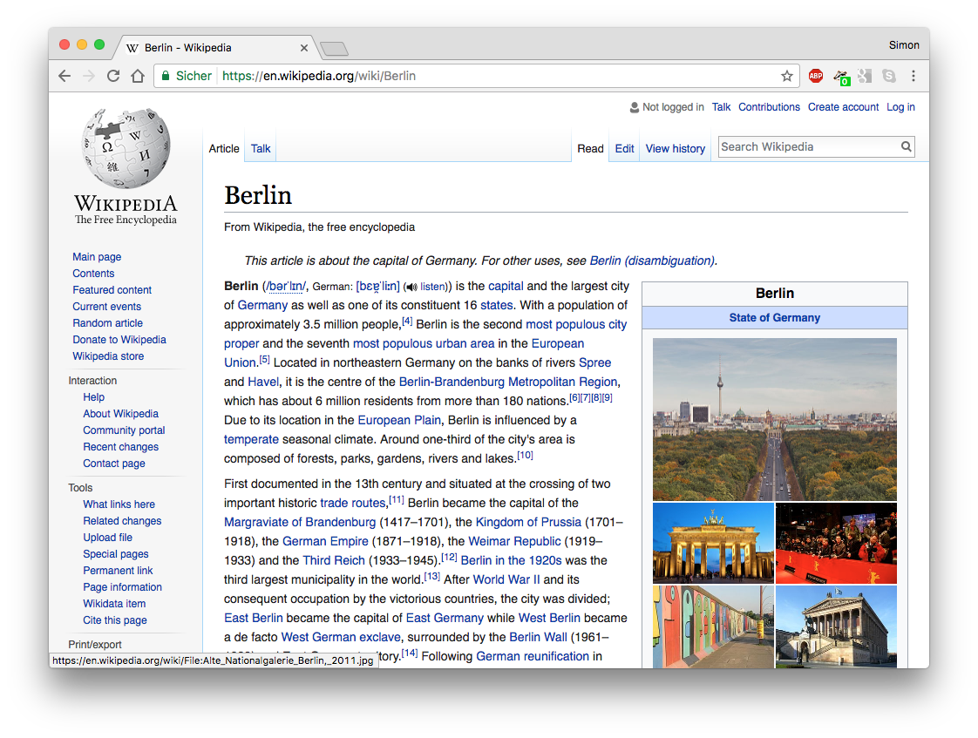
Data on the web

Slide 5
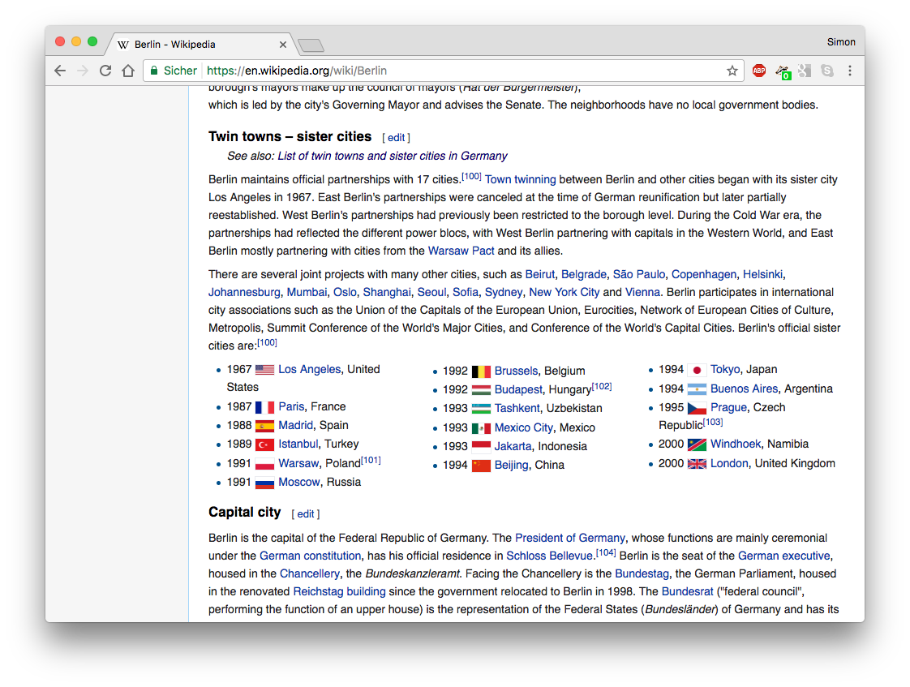
Data on the web

Slide 6
Let‘s grab these data!
# load packages
library(rvest)
library(stringr)
# scrape page source
cities_string <- read_html("https://en.wikipedia.org/wiki/Berlin") %>%
# extract list items
html_nodes(css = ".column-count-3 li") %>%
html_text()
cities_string
original URL
CSS selector
[1] "1967 Los Angeles, United States" "1987 Paris, France"
[3] "1988 Madrid, Spain" "1989 Istanbul, Turkey"
[5] "1991 Warsaw, Poland[101]" "1991 Moscow, Russia"
[7] "1992 Brussels, Belgium" "1992 Budapest, Hungary[102]"
[9] "1993 Tashkent, Uzbekistan" "1993 Mexico City, Mexico"
[11] "1993 Jakarta, Indonesia" "1994 Beijing, China"
[13] "1994 Tokyo, Japan" "1994 Buenos Aires, Argentina"
[15] "1995 Prague, Czech Republic[103]" "2000 Windhoek, Namibia"
[17] "2000 London, United Kingdom"

Slide 7
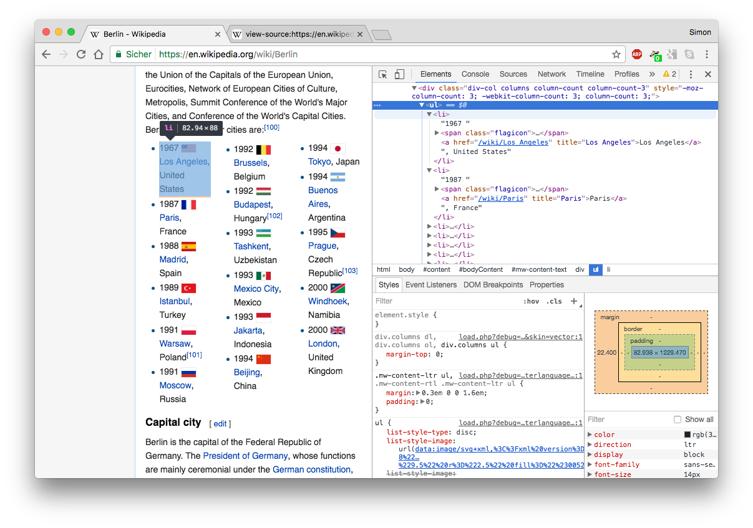
Why was this so easy?
view HTML source code
right-click,
„inspect element...“

Slide 8
Let‘s clean up these data!
# remove footnotes ([101], [102], ...)
cities_string <- str_replace(cities_string, "\\[\\d+\\]", "")
# extract data
year <- str_extract(cities_string, "\\d{4}")
city <- str_extract(cities_string, "[[:alpha:] ]+") %>% str_trim
country <- str_extract(cities_string, "[[:alpha:] ]+$") %>% str_trim
regular expression
[1] "1967 Los Angeles, United States" "1987 Paris, France"
[3] "1988 Madrid, Spain" "1989 Istanbul, Turkey"
[5] "1991 Warsaw, Poland" "1991 Moscow, Russia"
[7] "1992 Brussels, Belgium" "1992 Budapest, Hungary"
[9] "1993 Tashkent, Uzbekistan" "1993 Mexico City, Mexico"
[11] "1993 Jakarta, Indonesia" "1994 Beijing, China"
[13] "1994 Tokyo, Japan" "1994 Buenos Aires, Argentina"
[15] "1995 Prague, Czech Republic" "2000 Windhoek, Namibia"
[17] "2000 London, United Kingdom"

Slide 9
Let‘s clean up these data!
# remove footnotes ([101], [102], ...)
cities_string <- str_replace(cities_string, "\\[\\d+\\]", "")
# extract data
year <- str_extract(cities_string, "\\d{4}")
city <- str_extract(cities_string, "[[:alpha:] ]+") %>% str_trim
country <- str_extract(cities_string, "[[:alpha:] ]+$") %>% str_trim
regular expression
year[1:5]
[1] "1967" "1987" "1988" "1989" "1991"
city[1:5]
[1] "Los Angeles" "Paris" "Madrid" "Istanbul" "Warsaw"
country[1:5]
[1] "United States" "France" "Spain" "Turkey" "Poland"

Slide 10
Let‘s clean up these data!
# remove footnotes ([101], [102], ...)
cities_string <- str_replace(cities_string, "\\[\\d+\\]", "")
# extract data
year <- str_extract(cities_string, "\\d{4}")
city <- str_extract(cities_string, "[[:alpha:] ]+") %>% str_trim
country <- str_extract(cities_string, "[[:alpha:] ]+$") %>% str_trim
# put everything into data.frame
cities_df <- data.frame(year, city, country)
head(cities_df)
regular expression
year city country
1 1967 Los Angeles United States
2 1987 Paris France
3 1988 Madrid Spain
4 1989 Istanbul Turkey
5 1991 Warsaw Poland
6 1991 Moscow Russia

Slide 11
Let‘s map these data!
# geocode cities
library(ggmap)
cities_coords <- geocode(paste0(cities_df$city, ", ", cities_df$country))
cities_df$lon <- cities_coords$lon
cities_df$lat <- cities_coords$lat
# plot world map, add coordinates
map_world <- borders("world", colour = "gray50", fill = "white")
ggplot() + map_world + geom_point(aes(x = cities_df$lon, y = cities_df$lat), color = "red", size = 1) + theme_void()
query Google Maps API

Slide 12
Why web scraping with R?

Slide 13
Why web scraping?
A data analyst‘s view
data abundance online
social interaction online
services track social behavior
online data meant for display, not download
A pragmatists‘s view
financial resources
time resources
reproducibility
updateability
Web scraping is the business of
getting (unstructured) data from the web and
bringing it into shape (e.g., clean, make tabular format)

Slide 14
Why R?
free
open source
large community
powerful for statistical analysis
powerful for visualization
flexible in processing all kinds of data types
useful in every step of the workflow

Slide 15
Why R?
free
open source
large community
powerful for statistical analysis
powerful for visualization
flexible in processing all kinds of data types
useful in every step of the workflow

Slide 16
Web scraping with R at a glance

Slide 17
A beginner‘s toolbox (also helpful to experts)
rvest: easy web scraping (“harvesting”) suite
(by Hadley Wickham)
xml2: engine to parse XML-style files
(by Hadley Wickham and James Hester)
stringr: tools for string processing
(by Hadley Wickham)

Slide 18
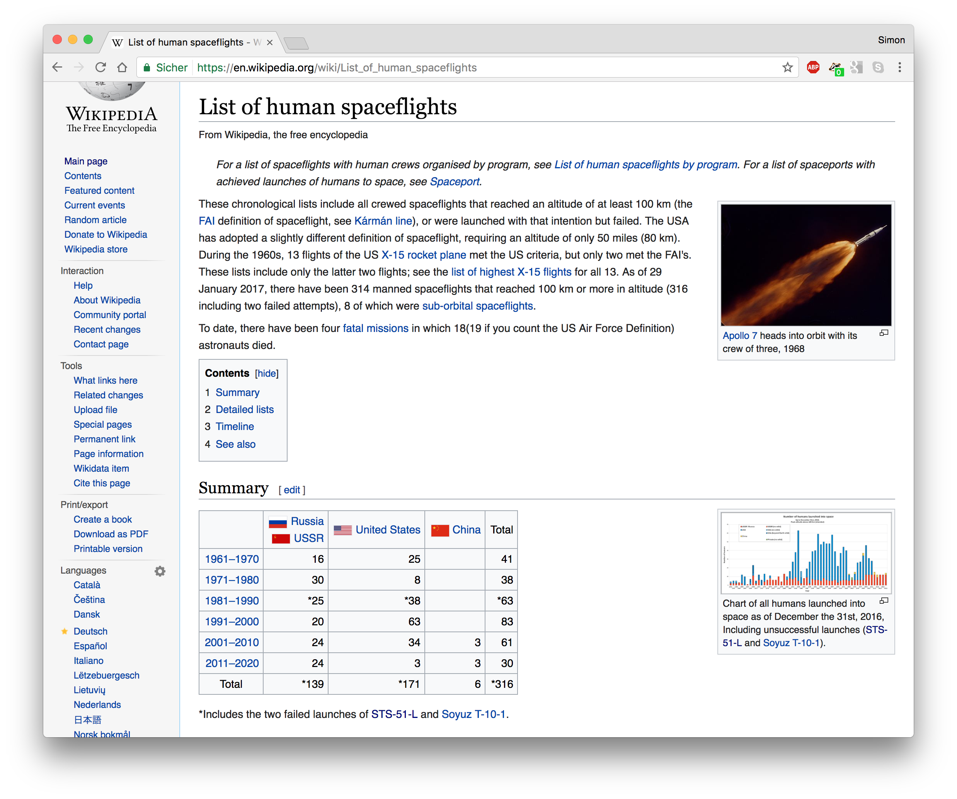
Scraping HTML tables

Slide 19
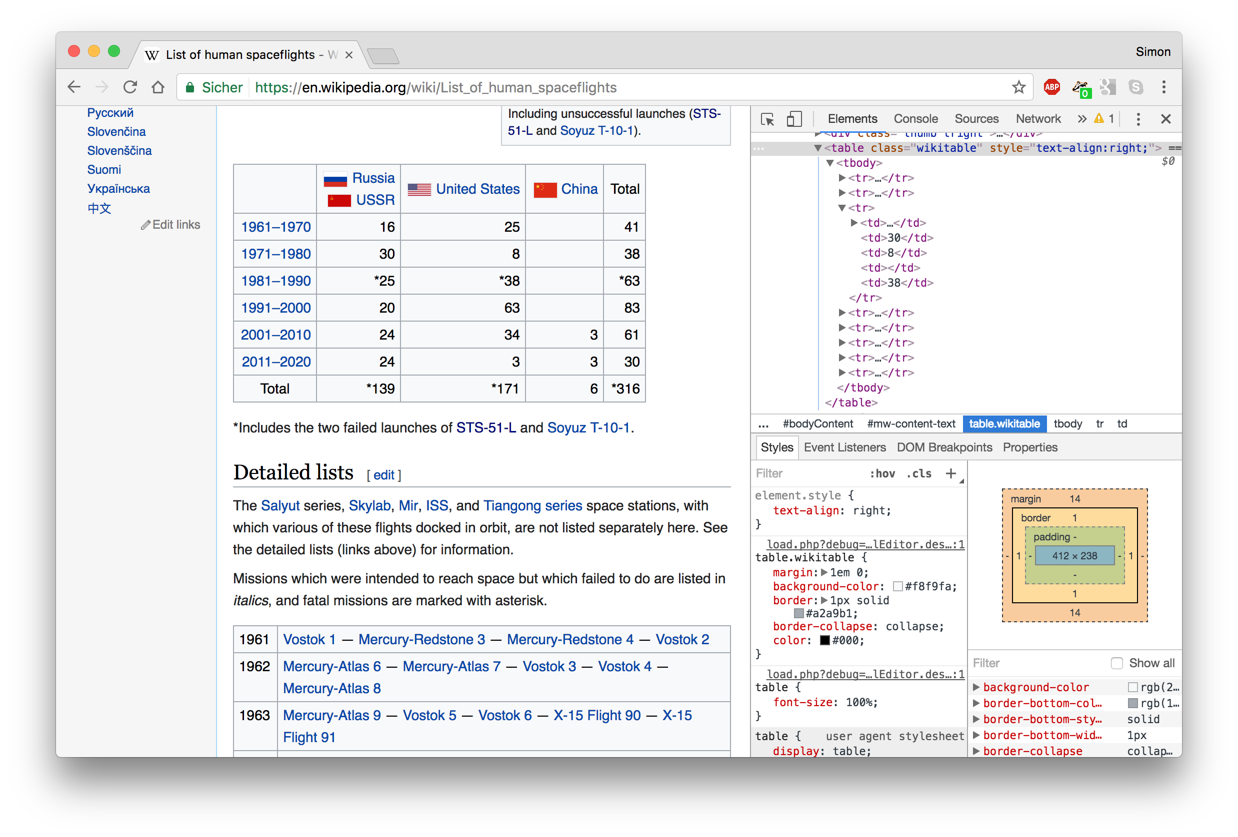
Scraping HTML tables
the web developer tools and source code inspector are your friends (remember: right-click, “inspect element...”)

Slide 20
Scraping HTML tables
the web developer tools and source code inspector are your friends (remember: right-click, “inspect element...”)
HTML tables use to share a common format
<table class="wikitable">
  <tr>
  <td></td>
  <td>Russia USSR</td>
  <td>United States</td>
  <td>China</td>
  <td>Total</td>
  </tr>
  <tr>
  <td>1961–1970</td>
  <td>16</td>
  <td>25</td>
  <td></td>
  <td>41</td>
  </tr>
  ...
</table>

Slide 21
Let‘s grab these data!
# load package
library(rvest)
# import webpage
url_p <- read_html("https://en.wikipedia.org/wiki/List_of_human_spaceflights")
# extract HTML tables
tables <- html_table(url_p, header = TRUE, fill = TRUE)
spaceflights <- tables[[1]]
spaceflights
Russia USSR United States China Total
1 1961–1970 16 25 NA 41
2 1971–1980 30 8 NA 38
3 1981–1990 *25 *38 NA *63
4 1991–2000 20 63 NA 83
5 2001–2010 24 34 3 61
6 2011–2020 24 3 3 30
7 Total *139 *171 6 *316

Slide 22
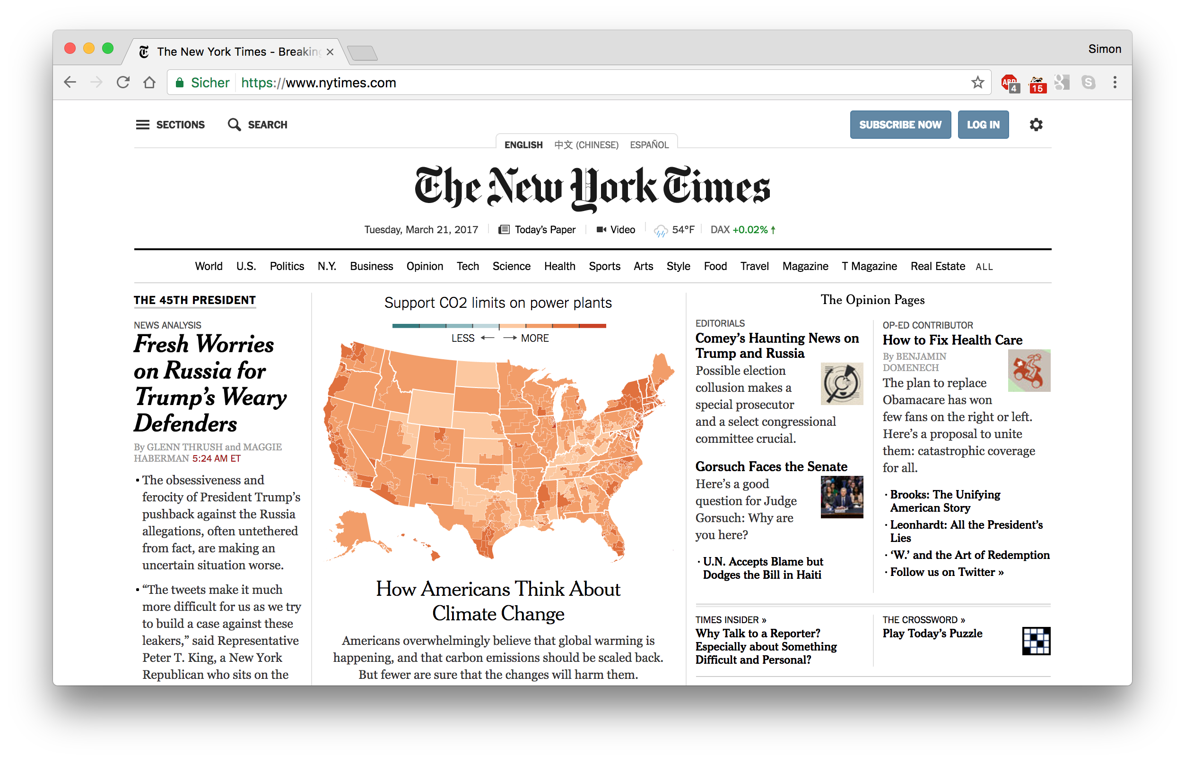
What if data do not come in nice HTML tables?

Slide 23
Easy solution: SelectorGadget
available at http://selectorgadget.com/, works as browser plugin
helps you construct CSS selectors (or XPath expressions)
with SelectorGadget, you can
click on elements you want to scrape
un-click elements you do not want to scrape
“point-and-click” the information you are interested in
caveat: solves 80% of your standard scraping tasks – for the rest, learn how to build CSS selectors / XPath expressions

Slide 24
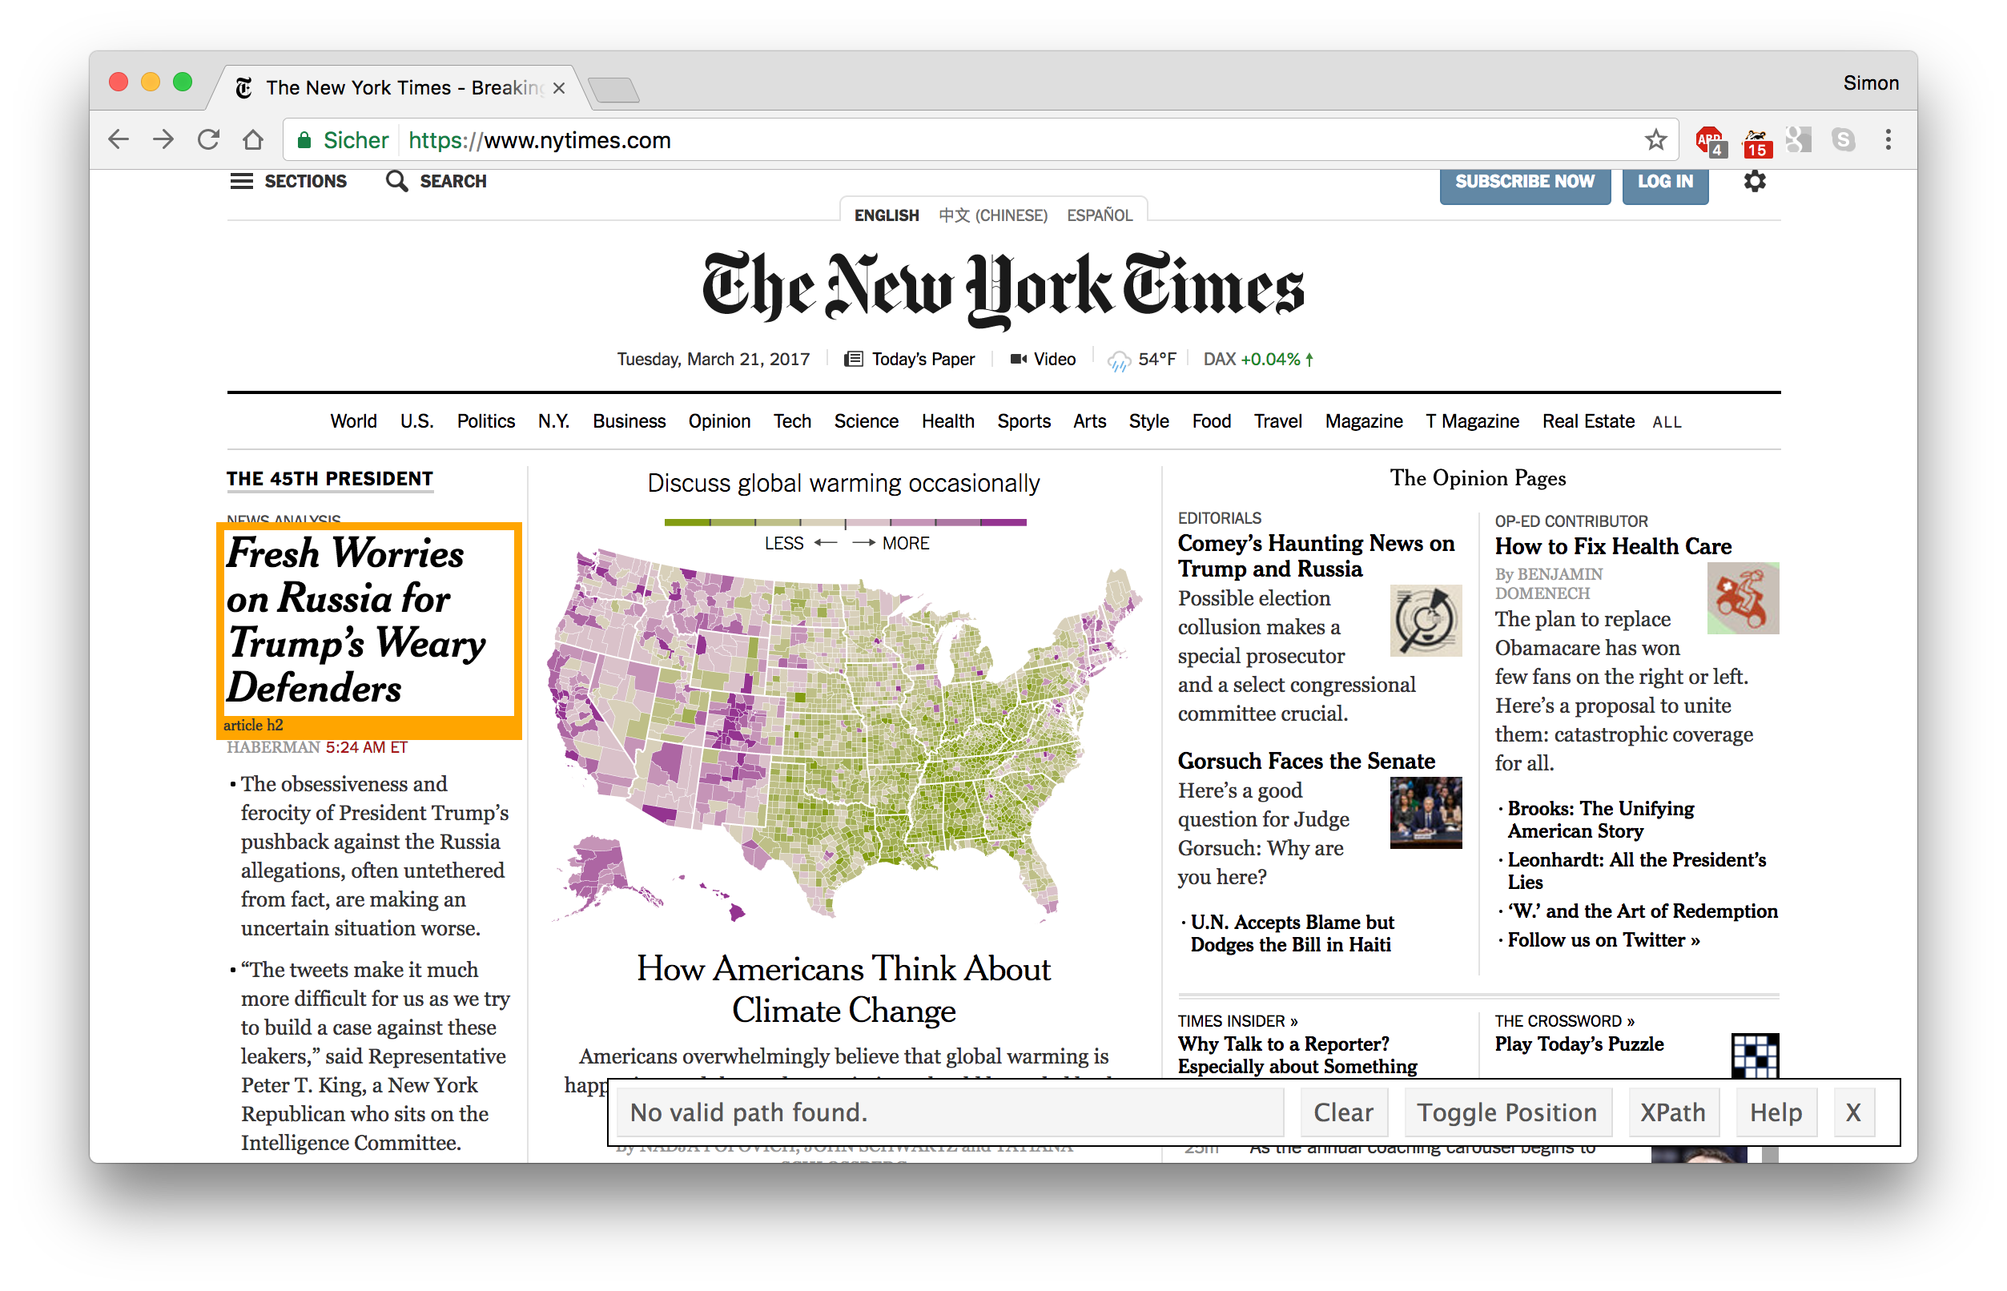
SelectorGadget
select elements via point-and-click

Slide 25
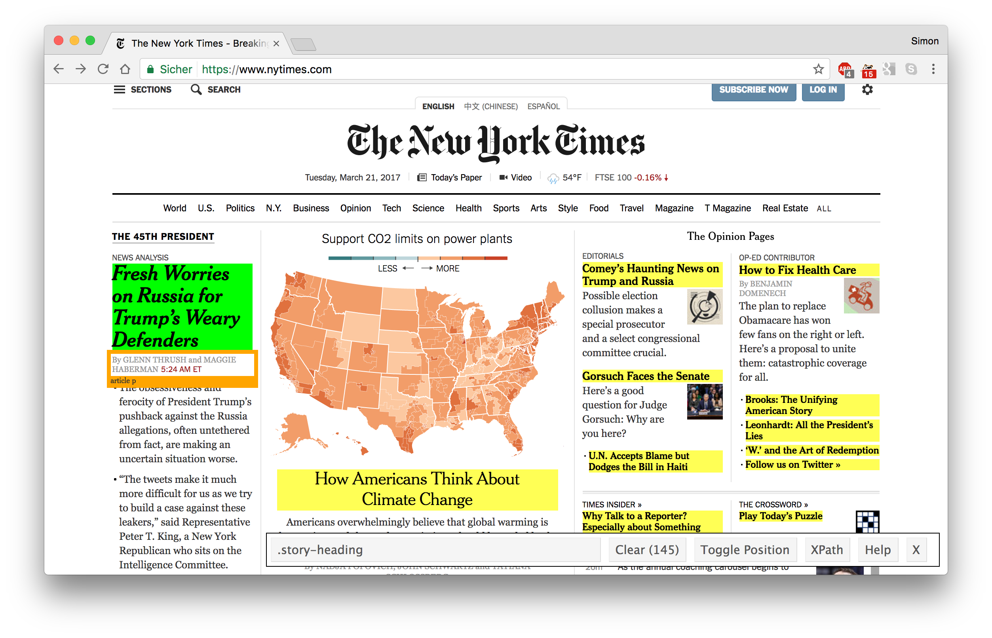
SelectorGadget
magic!
CSS selector
# elements detected

Slide 26
Let‘s grab these data!
# load package
library(rvest)
# import webpage
url_p <- read_html("https://www.nytimes.com")
# look for nodes (parts of the HTML document that we want to extract)
headlines <- html_nodes(url_p, css = ".story-heading")
# extract the headline text
headlines_raw <- html_text(headlines)
head(headlines_raw)
[1] "Fresh Worries on Russia for Trump’s Weary Defenders" [2] "F.B.I. Confirms Inquiry on Trump Team’s Russia Ties" [3] "Takeaways From the Hearing " [4] "\n Trump and the Russians: Links? No Links?" [5] "G.O.P. Responds by Changing Subject" [6] "U.S. Limits Devices on Foreign Airlines From 8 Countries"

Slide 27
Let‘s clean up these data!
# remove line breaks and empty spaces
headlines_clean <- headlines_raw %>% str_replace_all("\\n", "") %>% str_trim()
# how many headlines contain the word "Trump"?
str_detect(headlines_clean, "Trump") %>% table()
FALSE TRUE
133 12

Slide 28
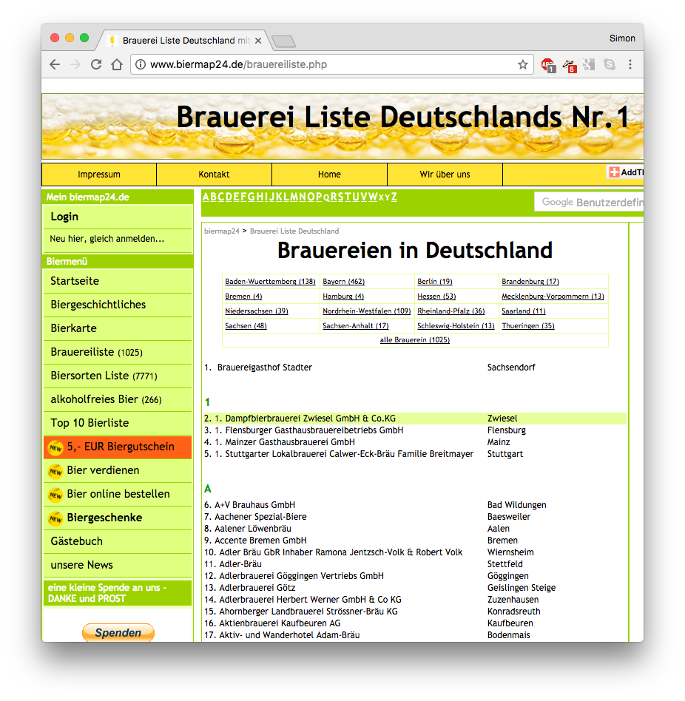
Other scraping scenarios
cities[1:15]
[1] "Flensburg" "Mainz" [3] "Stuttgart" "Bad Wildungen" [5] "Baesweiler" "Aalen" [7] "Bremen" "Wiernsheim" [9] "Stettfeld" "Göggingen" [11] "Geislingen Steige" "Zuzenhausen" [13] "Konradsreuth" "Kaufbeuren" [15] "Bodenmais"
pull information out of lists
geocode cities

Slide 29
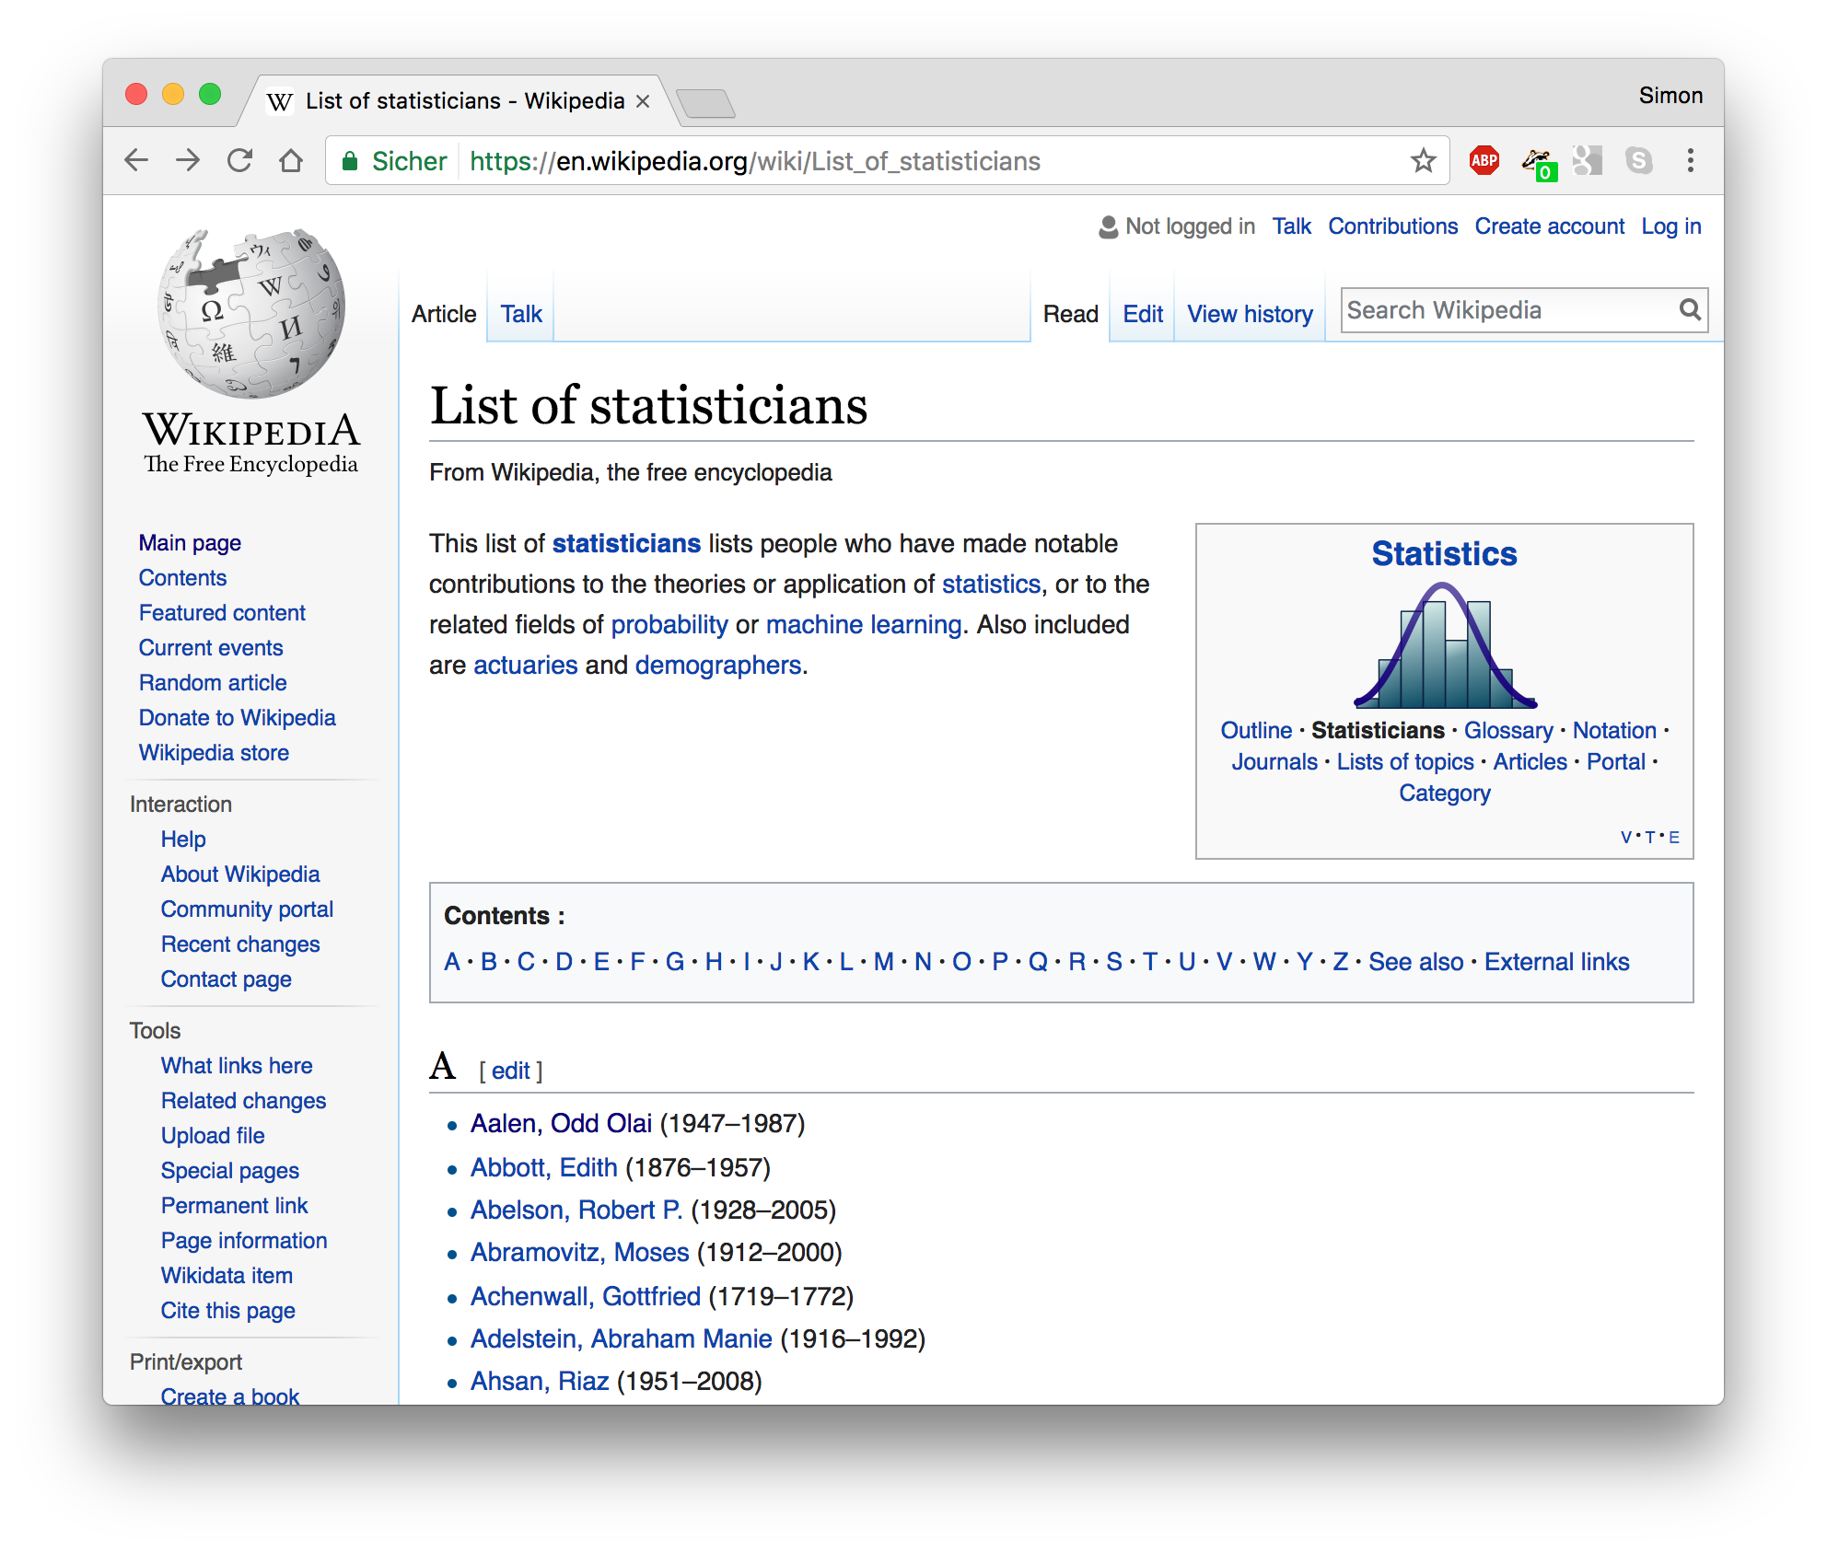
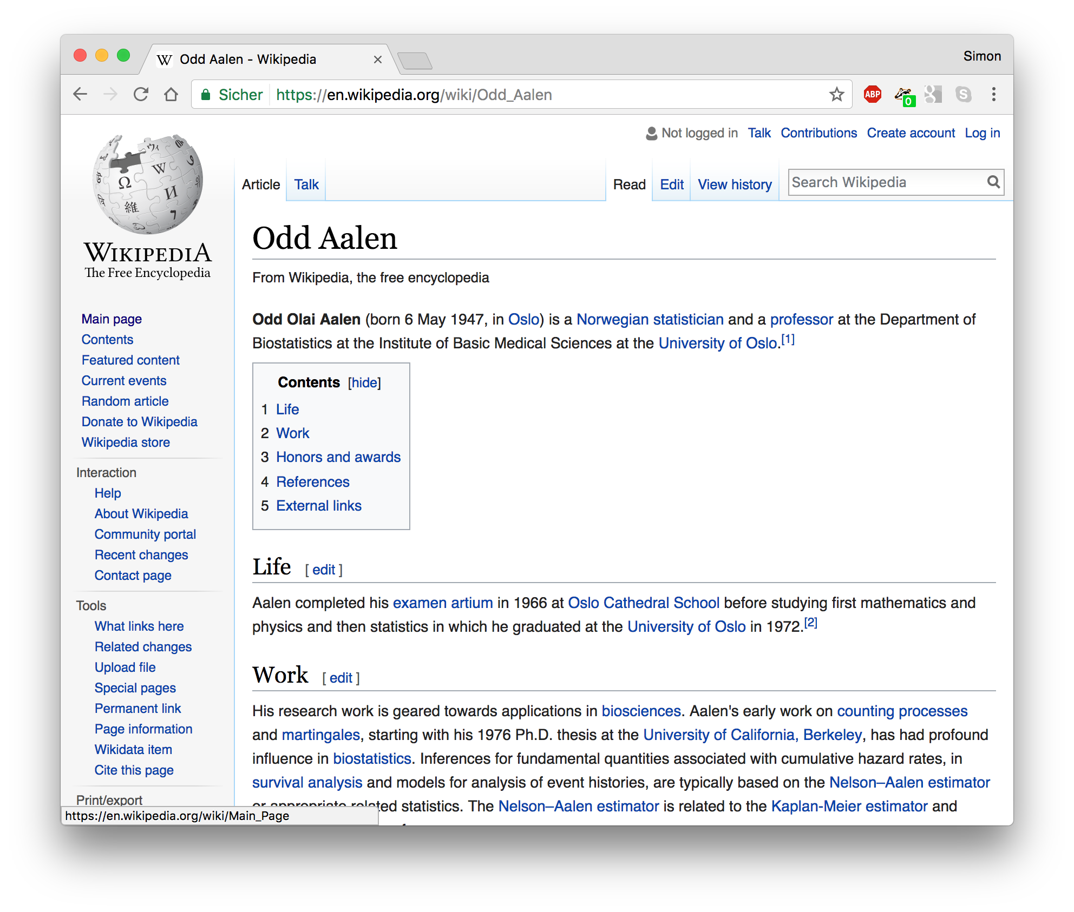
Other scraping scenarios
download hundreds of (thousands of) HTML pages
pull information from multiple websites
identify links between HTML documents

Slide 30
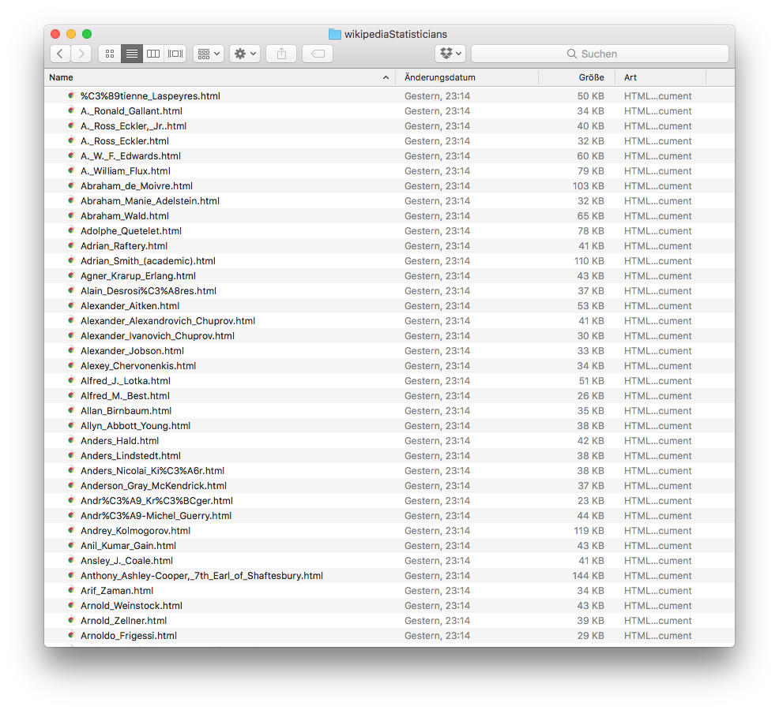
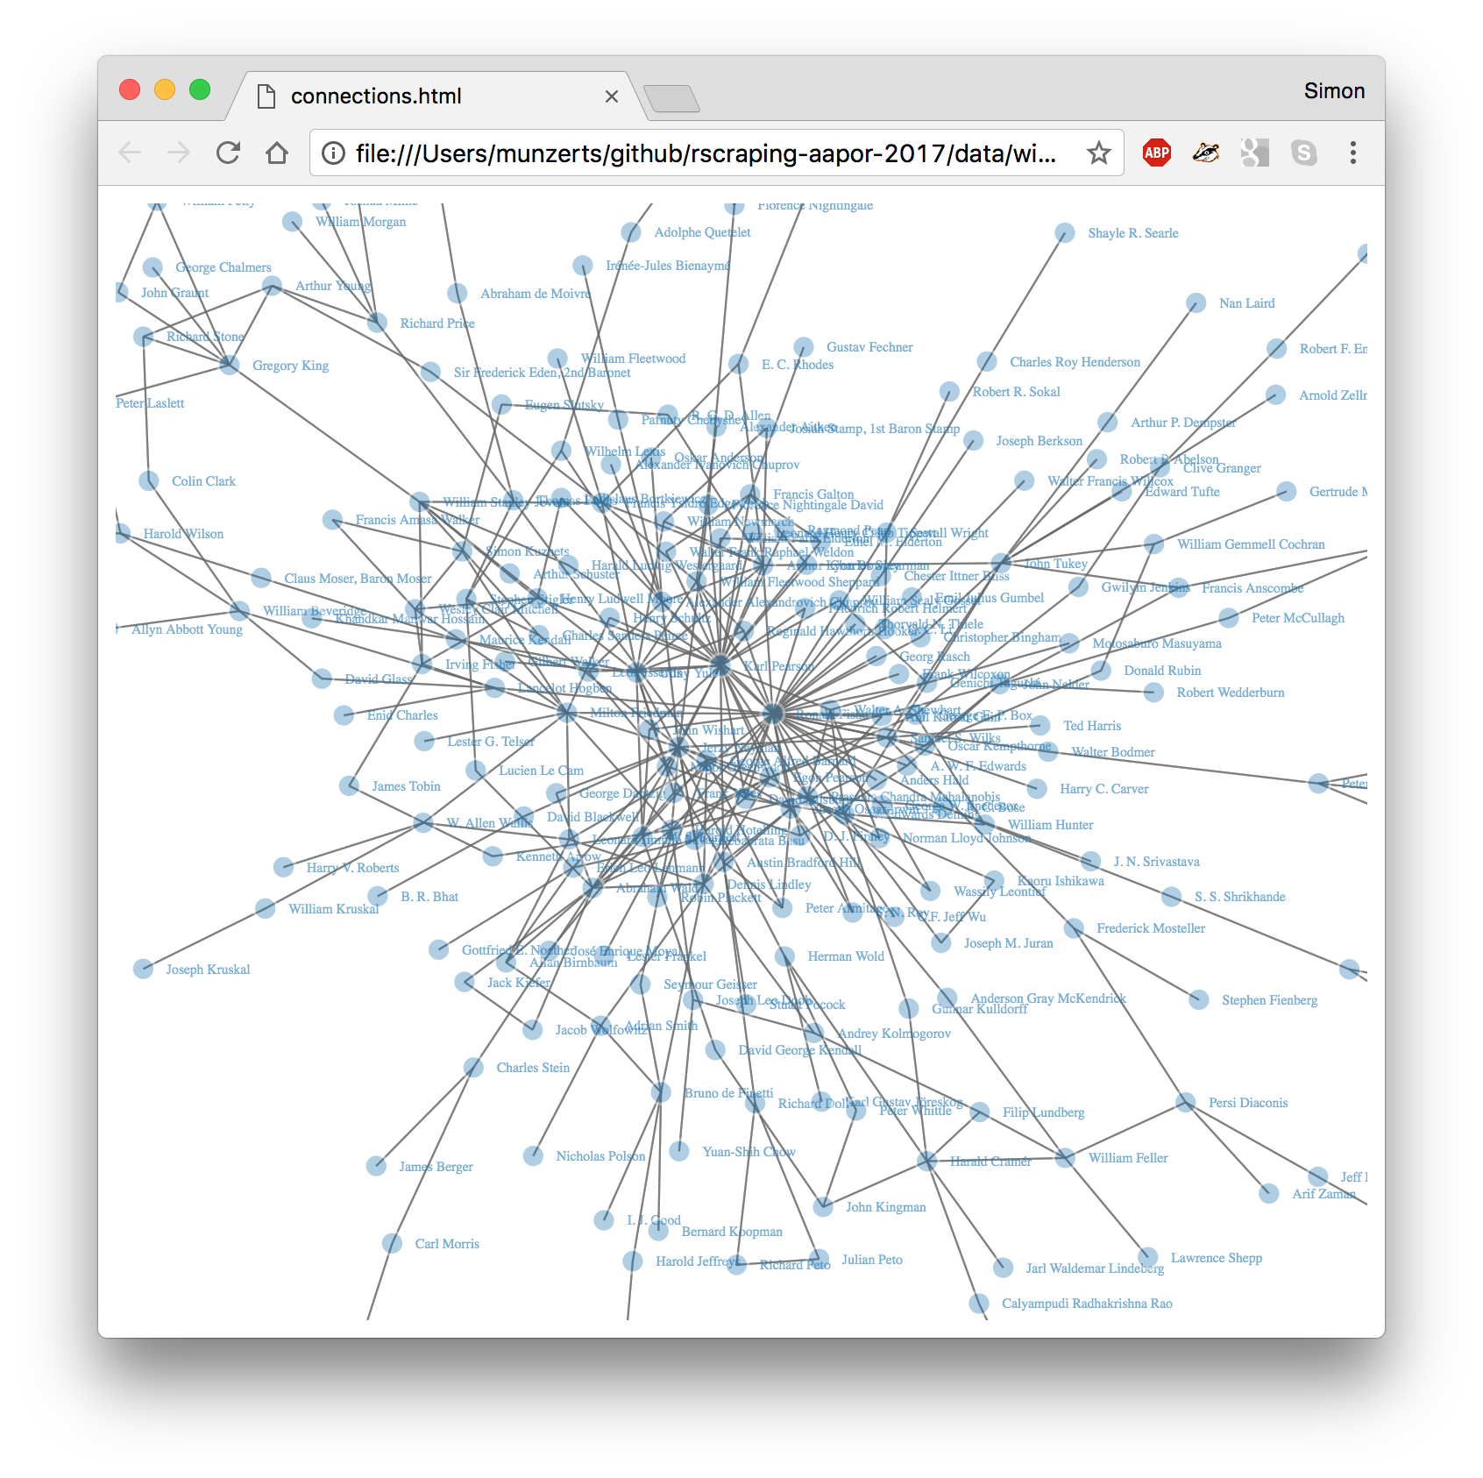
Other scraping scenarios
download hundreds of (thousands of) HTML pages
pull information from multiple websites
identify links between HTML documents

Slide 31
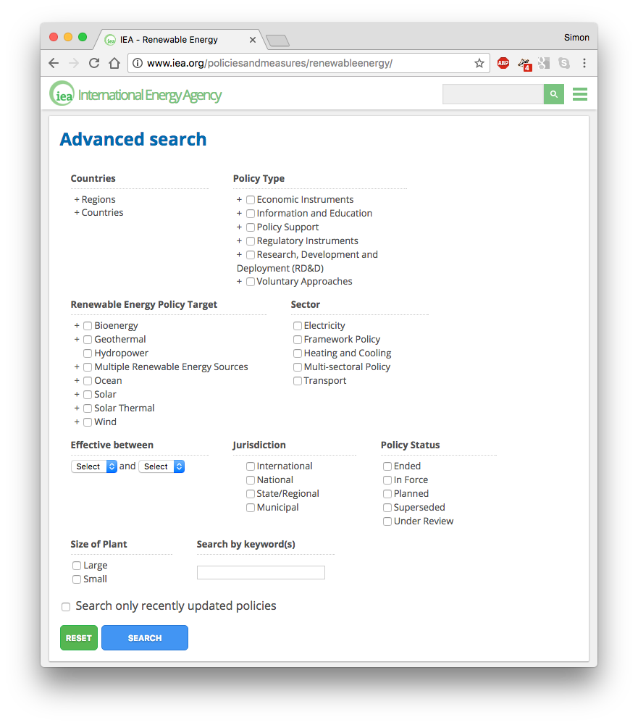
Other scraping scenarios
gather data from dynamically rendered websites
...one of the more complex scraping scenarios
click here

Slide 32
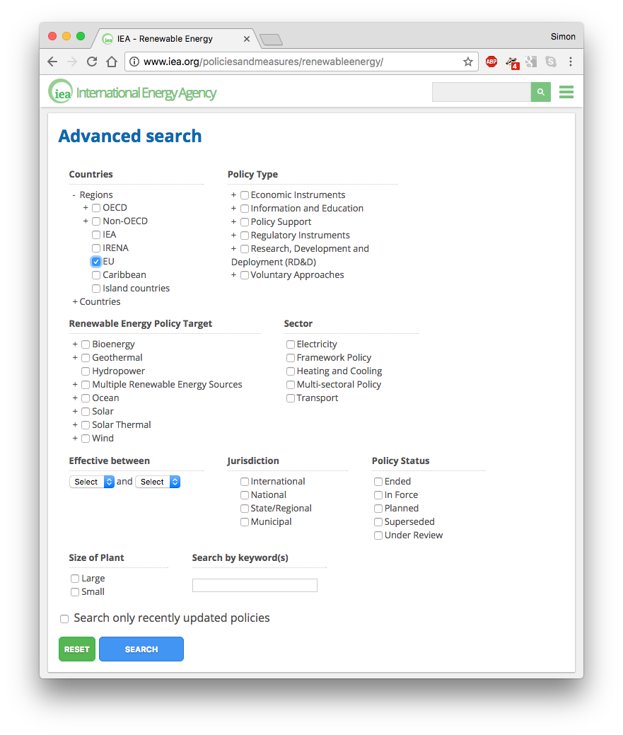
Other scraping scenarios
gather data from dynamically rendered websites
...one of the more complex scraping scenarios
URL does not change
click here

Slide 33
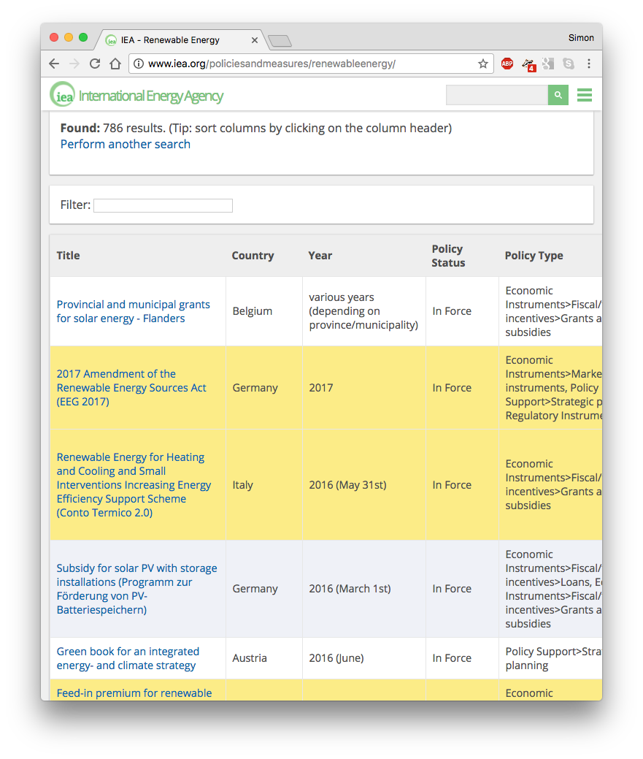
Other scraping scenarios
gather data from dynamically rendered websites
...one of the more complex scraping scenarios
URL does not change
make use of RSelenium together with Selenium Webdriver
the basic idea: simulate activities in the browser with R, e.g. “click here“, “type something there“, and log the results using external software

Slide 34
Wrap-up
the rvest package is your friend (plus SelectorGadget plus regular expressions)
you don‘t have to become an HTML expert, but looking into a website‘s source code helps
scraping data from static HTML tables can be as easy as this:
# load package
library(rvest)
# parse html
url_parsed <- read_html("https://www.example.com")
# extract table(s)
tables <- html_table(url_parsed, fill = TRUE)
your_table <- tables[[1]]
# tidy data
your_clean_table <- magic_data_tidier(your_table)

Slide 35
Wrap-up
the rvest package is your friend (plus SelectorGadget plus regular expressions)
you don‘t have to become an HTML expert, but looking into a website‘s source code helps
scraping data from static HTML pages can be as easy as this:
# load package
library(rvest)
# parse html
url_parsed <- read_html("https://www.example.com")
# extract content you like with CSS selector
nodes <- html_nodes(url_parsed, css = “CSS selector”)
your_data <- html_text(nodes)
# tidy data
your_clean_data <- magic_data_tidier(your_data)

Slide 36
Tapping APIs with R at a glance

Slide 37
What are APIs?
Application Programming Interface
many web services provide APIs to access their data and services (Google, Twitter, Facebook, Wikipedia, ...)
often works like a “data search engine”: you pose a request, the API answers with a bulk of data
common data return formats: JSON, XML
APIs in the context of web scraping
instant access to clean data
frees you from building manual scraping problems
collecting data from the web using APIs provided by the data owner represents the gold standard of web-based data retrieval

Slide 38
Example: Google Maps API
Google provides access to powerful location services
free service (at least when used modestly)
input/output: places, names, coordinates, meta information, maps, ...
see also: https://developers.google.com/maps/documentation/
Potential use cases
geocode observations based on address, city, post code, ...
calculate distances between observations
map observations

Slide 39
Example: Google Maps API
library(ggmap)
geocode(“Humboldt University, Berlin”)
Source : https://maps.googleapis.com/maps/api/geocode/json?address= Humboldt%20University%2C%20Berlin
lon lat
1 13.39366 52.51788
Excerpt from raw JSON
{
"address_components" : [
{ "long_name" : "Germany",
"short_name" : "DE",
"types" : [ "country", "political" ]},
{ "long_name" : "10099",
"short_name" : "10099",
"types" : [ "postal_code“] }
],
"formatted_address" : "Unter den Linden 6, 10099 Berlin, Germany", "location" : { "lat" : 52.517883, "lng" : 13.3936551 },
"place_id" : "ChIJI0K8KtZNqEcRxSbyV3Fx5Kk",
"types" : [ "establishment", "point_of_interest", "university" ]
}

Slide 40
Example: Google Maps API
library(ggmap)
geocode(“Humboldt University, Berlin”)
get_googlemap(“Humboldt University, Berlin”, zoom = 12, maptype = “hybrid”) %>% ggmap()

Slide 41
Example: Google Maps API
library(ggmap)
geocode(“Humboldt University, Berlin”)
get_googlemap(“Humboldt University, Berlin”, zoom = 12, maptype = “hybrid”) %>% ggmap()
ggmap_credentials()
Google -
key :
account_type : standard
day_limit : 2500
second_limit : 50
client :
signature :

Slide 42
Example: Twitter APIs
Twitter provides access to much of their data for free
output: user profile, follower data, tweet collections (keyword-based), ...
registration mandatory (see, e.g., http://bit.ly/2mM4WwV)
see also: https://dev.twitter.com/rest/public
Potential use cases
analyze users‘ output (tweets, retweets)
analyze follower networks
real-time tracking of activity on the platform

Slide 43
Example: Twitter APIs
library(rtweet)
## search for tweets
tweets_aapor <- search_tweets("#AAPOR", n = 100)
names(tweets_aapor)
tweets_aapor$text[1:3]
Searching for tweets...
Finished collecting tweets!
[1] "screen_name" "user_id" "created_at"
[4] "status_id" "text" "retweet_count"
[7] "favorite_count" "is_quote_status" "quote_status_id"
[10] "is_retweet" "retweet_status_id" "in_reply_to_status_status_id“
[13] "in_reply_to_status_user_id" "in_reply_to_status_screen_name" "lang“
[16] "source" "media_id" "media_url" [19] "media_url_expanded" "urls" "urls_display" [22] "urls_expanded" "mentions_screen_name" "mentions_user_id" [25] "symbols" "hashtags" "coordinates" [28] "place_id" "place_type" "place_name" [31] "place_full_name" "country_code" "country" [34] "bounding_box_coordinates" "bounding_box_type"
[1] "Come on, #AAPOR research nerds. I know you want to register for this. https://t.co/GpS7vGX6pb"
[2] " @kyleymcg: Have you registered for the next #AAPOR Webinar on 4/12? A Primer to Web Scraping w/ R by @simonsaysnothin https://t.co/exFDD… "
[3] " @AAPOR: 2017 #AAPOR Award Winners Announced and will be honored during the Annual Conference in New Orleans. https://t.co/eLfP0F5iNR "

Slide 44
Wrap-up
Advantages of data gathering with APIs
pure data collection without “layout waste“
standardized data access, robustness of calls
de facto automatic agreement of data owner
Potential pitfalls
requires you to understand the basics of the API architecture (or to the piece of software that links to it, e.g., an R package)
dependent upon API suppliers; sometimes requires registration
not always free

Slide 45
Wrap-up
Resources
Collection of APIs on the web: http://www.programmableweb.com/apis
rOpenSci: Collection of R-API interfaces: http://ropensci.org/packages/
Twitter mining with R: https://mkearney.github.io/rtweet/index.html

Slide 46
Outlook and helpful resources

Slide 47
Web technologies

Slide 48

Three next steps for you (takes less than 3 hours)
Go to the following website and the repository to your desktop:
https://git.io/vyAde
Start with opening 01-intro.r and work through the commented R code. Then do the same with
02-scraping-with-rvest.r
By modifying existing examples in the code, get better at understanding the individual steps in the process and ultimately start your own scraping projects

Slide 49
Midterm goals to become a seasoned web scraper (takes 3-5 projects)
Learn to understand and construct regular expressions
http://stat545.com/block022_regular-expression.html
Learn to build CSS selectors (or XPath expressions) by hand
http://flukeout.github.io/
Integrate more packages in your scraping toolbox
https://cran.r-project.org/ web/views/WebTechnologies.html

Slide 50
An accompanying book
covers the entire scraping workflow in R and:
fundamentals of web technologies (HTTP, HTML, XML, JSON, XPath)
regular expressions
text mining
much more
published in late 2014 → not entirely up-to-date anymore (we‘re working on 2nd ed.)
homepage with materials:
r-datacollection.com

Slide 51



Other useful books on the market
modern intro to R
available for free at:
http://r4ds.had.co.nz/
helpful at establishing robust (scraping) workflow
web scraping works with other programming languages, too!

Slide 52
Slides and Materials:
https://git.io/vyAde
Book:
r-datacollection.com
@RDataCollection
Me:
simonmunzert.github.io
github.com/simonmunzert
@simonsaysnothin
Notes:
CANNED QUESTIONS:
What about the legal implications of web scraping? When am I allowed to scrape data from pages, and when not?
Content on the web changes all the time. How can I make my scraping program robust against these changes?
I have a basic familiarity with R, but my working environment is dominated by SPSS. Should I still learn how to scrape the web with R, or are there good alternatives?

